Slide 1
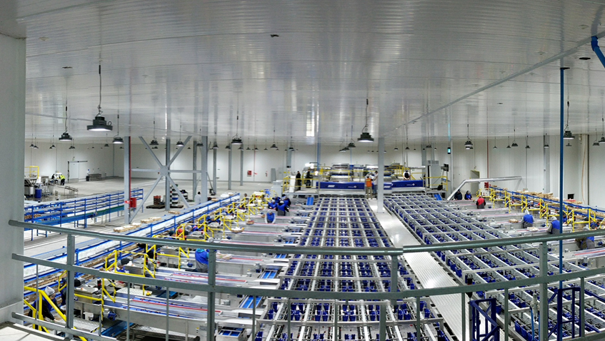
Smart Postharvest Systems to bridge Biology, Automation, and Artificial Intelligence

Slide 2
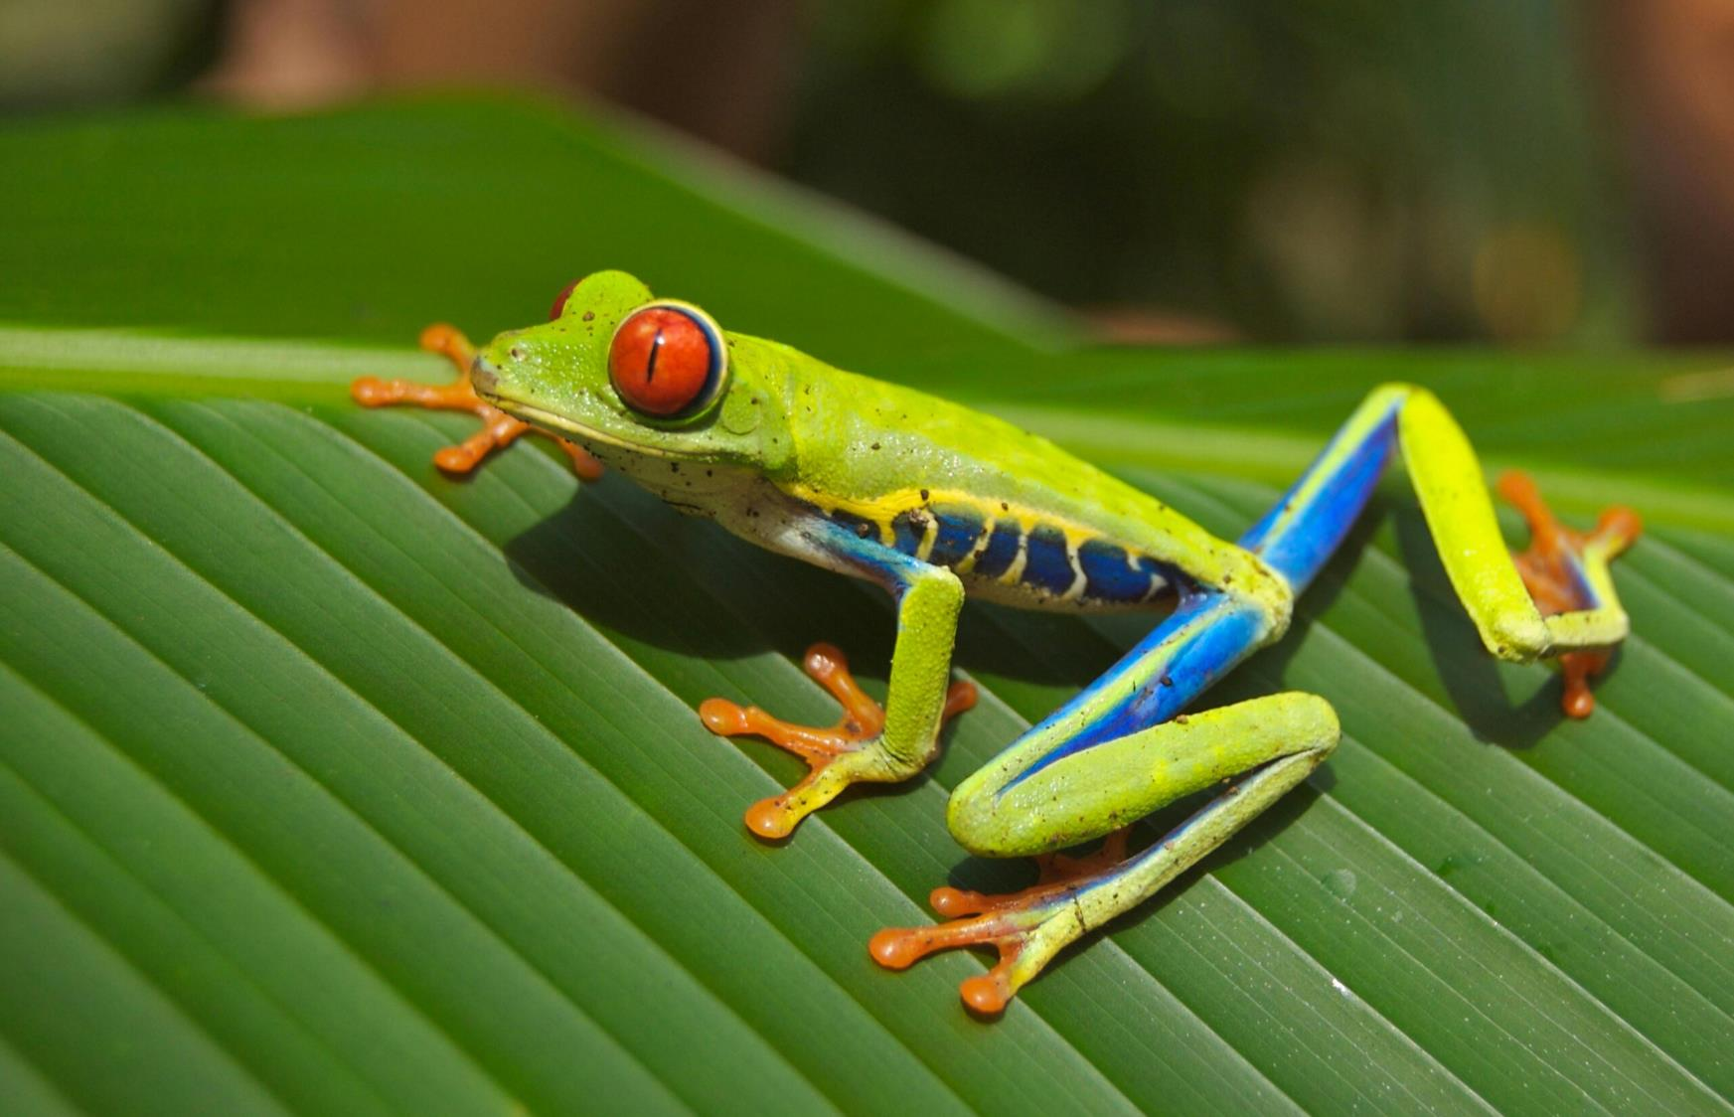

AFTER HARVEST FOOD IS:
ALIVE
BREATHING
RELEASING HEAT
LOOSING MOISTURE
GETTING SICK
CAN DIE

Slide 3
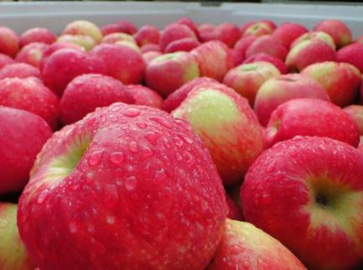
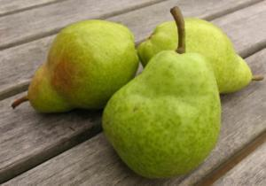
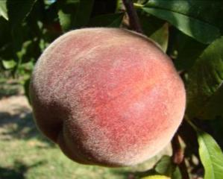
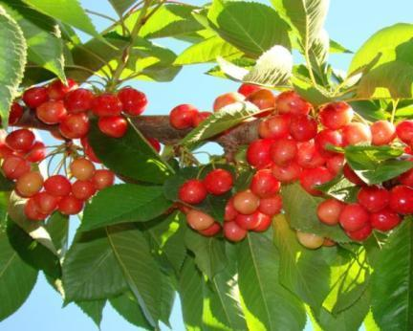
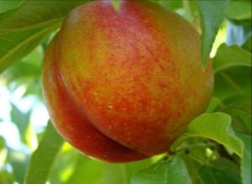
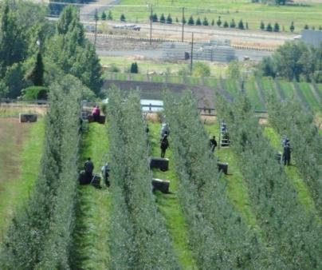
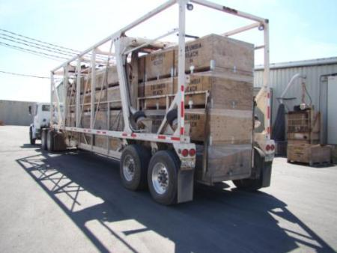
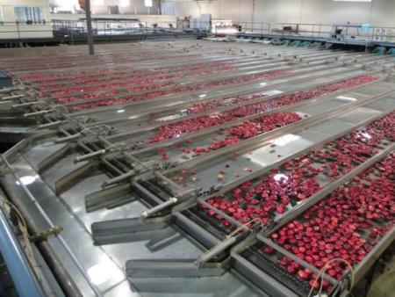
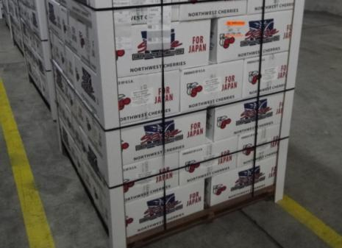
Overview
Harvest
Transport
Storage
Packing
Shipping

Slide 4
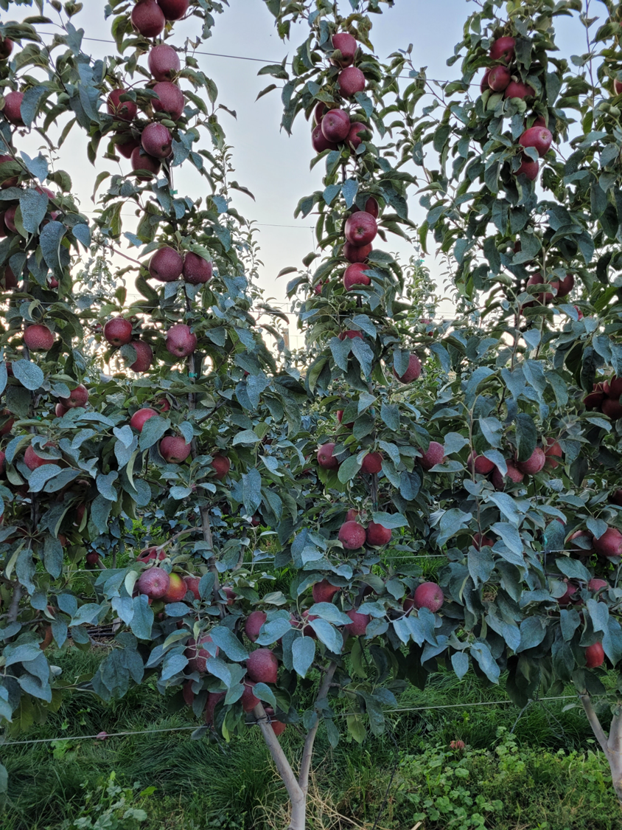

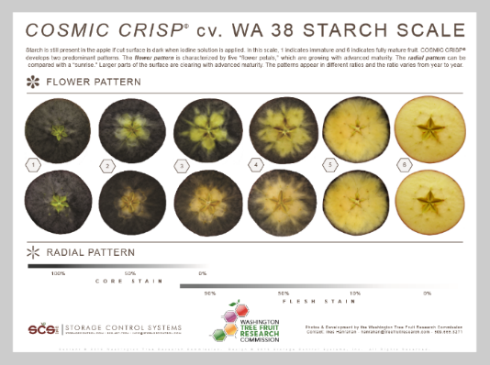
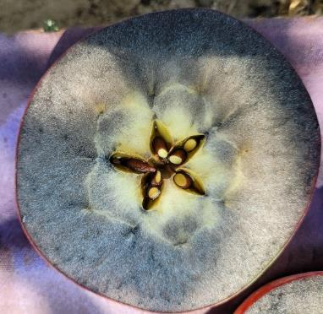
When do we pick?

Slide 5

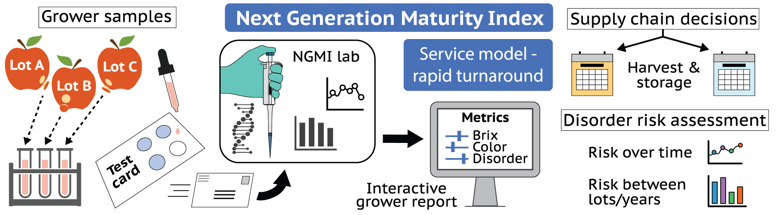
Next Generation Maturity Indices concept model
Lot A
Lot B
Lot C
Project lead: Honaas lab with USDA ARS in Wenatchee
Notes:
The Honaas lab with USDA ARS in Wenatchee is developing new technology to estimate maturity, and there for maturity linked traits, in pome fruit.
This concept model shows how this technology might work as a service model, where we take crude RNA preps and mail them to a lab for PCR analysis. We run the data in sophisticated models to estimate differences in maturity. Then, a digital grower report could be used to help make supply chain decisions.
We have done more work in apples, where models work to predict storability across cultivars, but we now have preliminary models for European pear.
*click for transition*
This accomplished 2 things:
1) Critical steps towards technology to help make supply chain decisions for pear, especially with regard to conditioning,
2) Strengthens our overall approach by adding a powerful comparative dimension
We are looking at gene activity signatures that can be used to estimate fruit maturity and future fruit quality. By doing experiments in APPLES AND PEARS we increase our chances to find robust and reliable markers that work across cultivars, and may even species – this is because the ancestor of apples and pears was likely a climacteric pome fruit species, and the same “maturity genes” were inherited by both crop species.

Slide 6
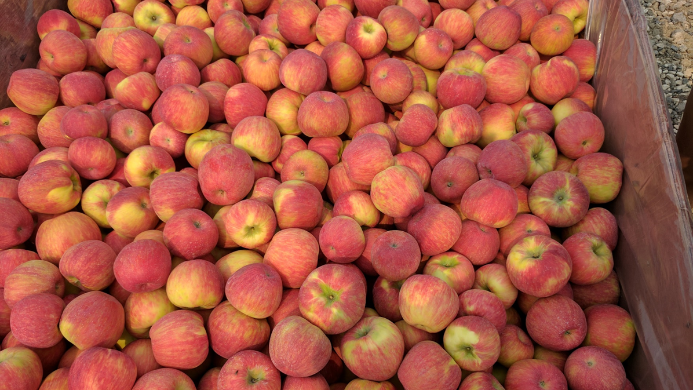
What do we have?

Slide 7
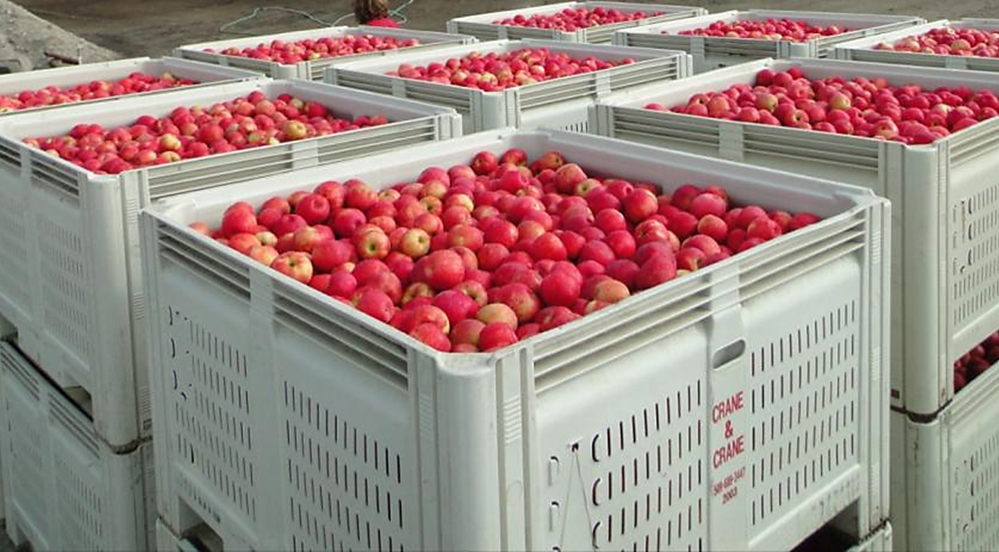
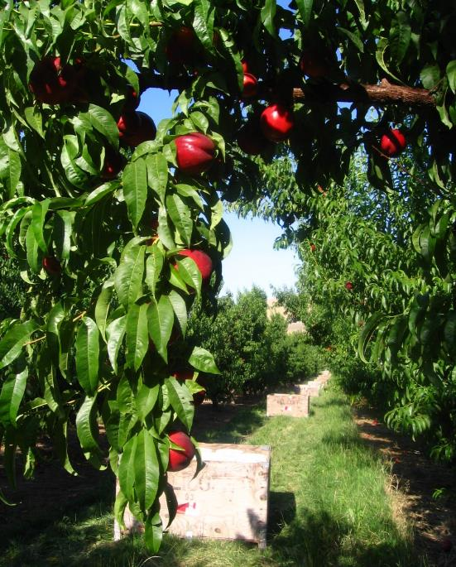
What do we have?

Slide 8
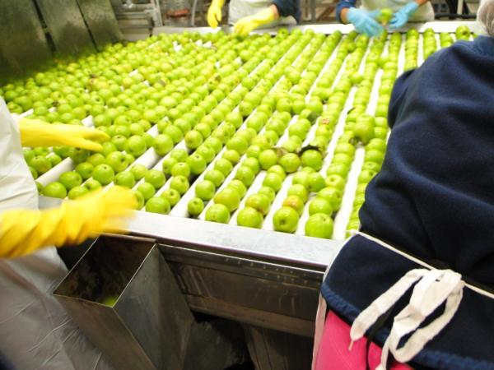
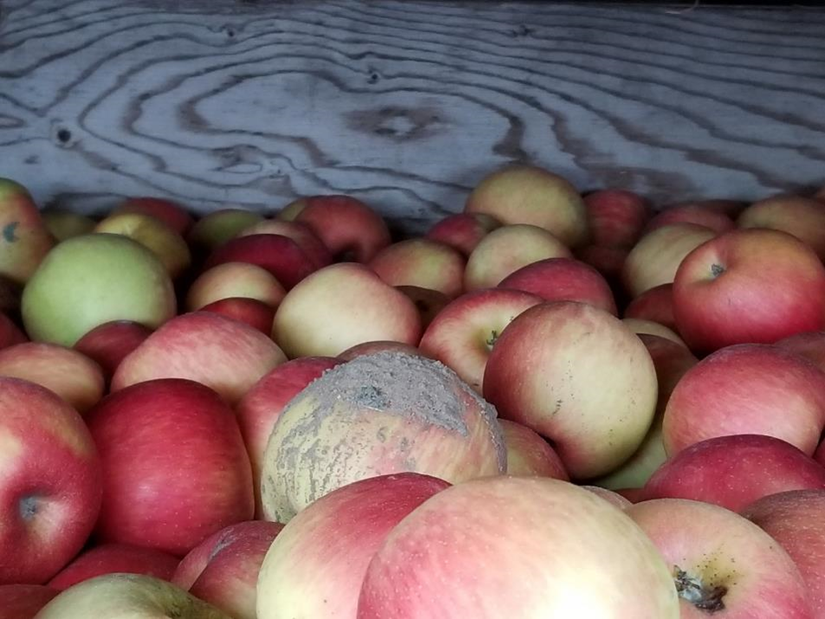
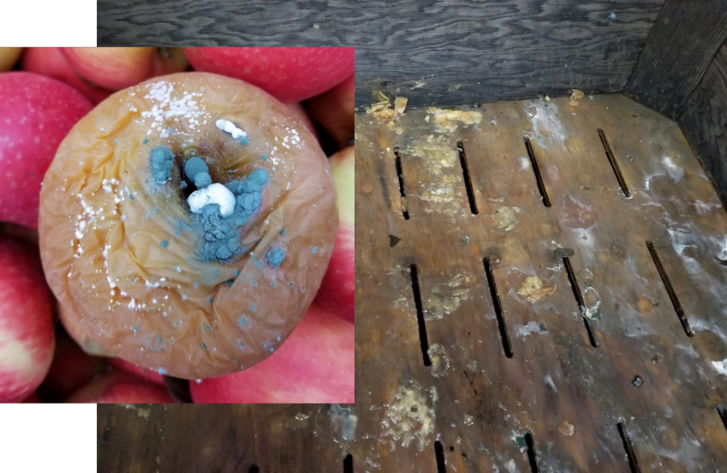
Decay Management: From Simplicity to Complexity
https://www.sciencedirect.com/science/article/abs/pii/S0925521416301065

Slide 9
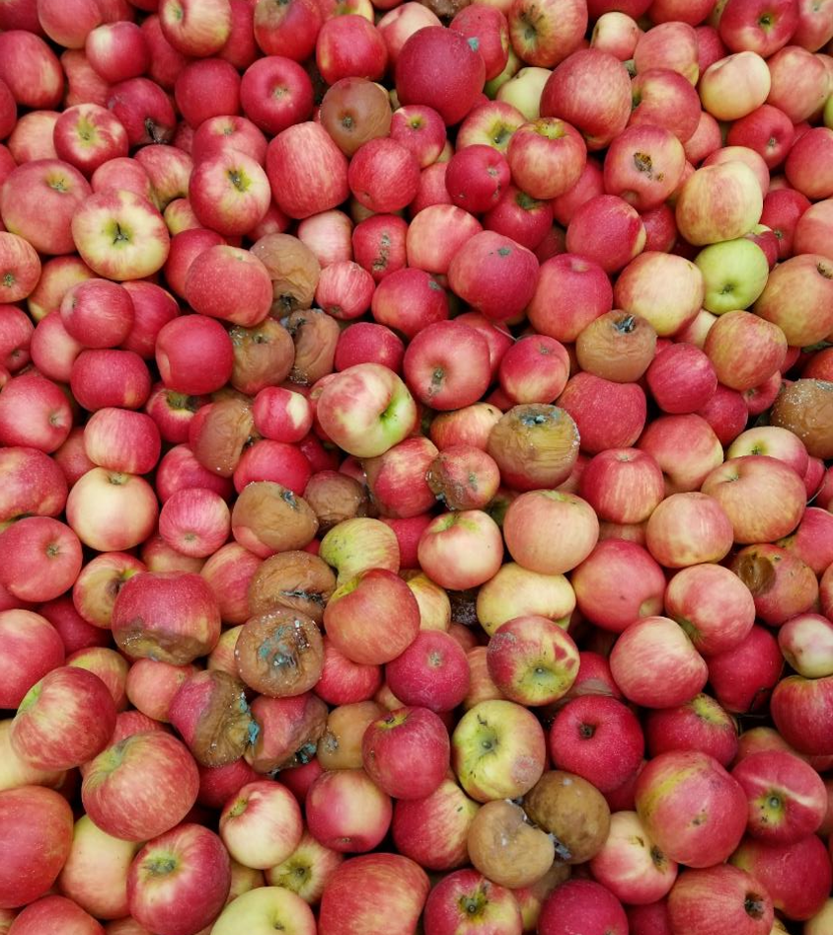
How long should we store it?

Slide 10
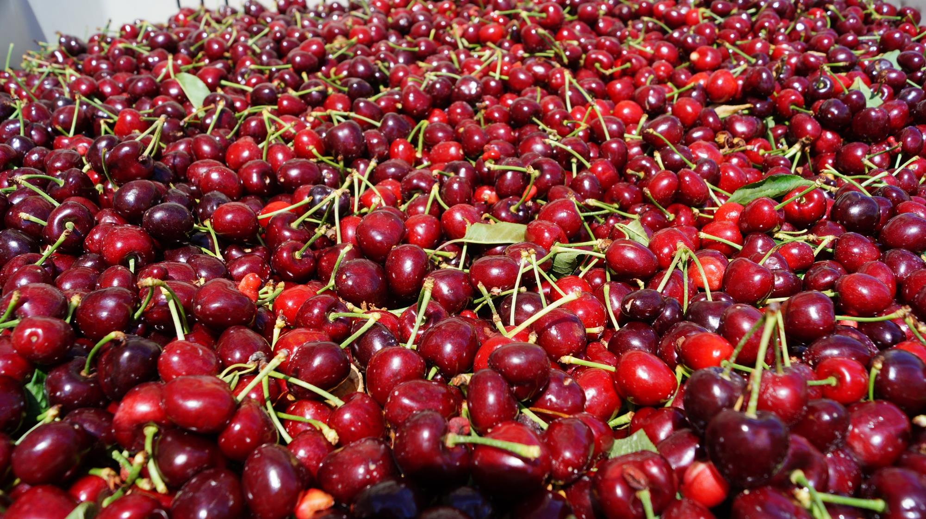

Slide 11
Packinghouse Operations Cherries
• Dump tank
• Leaf eliminator (blower)
• Cluster cutter & small fruit eliminator
• Sorting
• Hydrocooling
• Fruit sizing
• Grading & box filling
• Modified atmosphere packaging (optional)

Slide 12
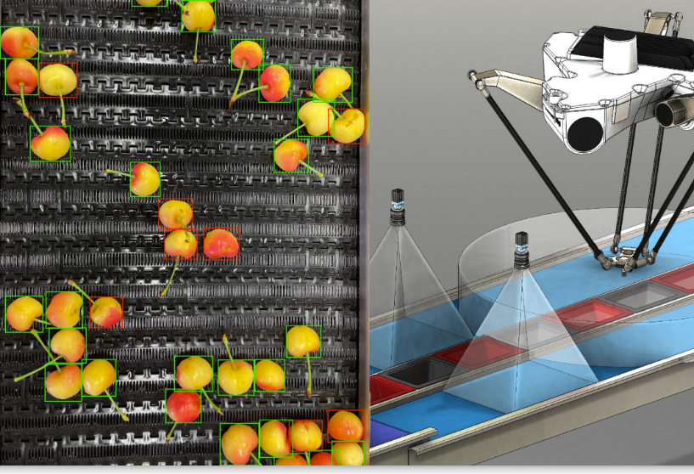
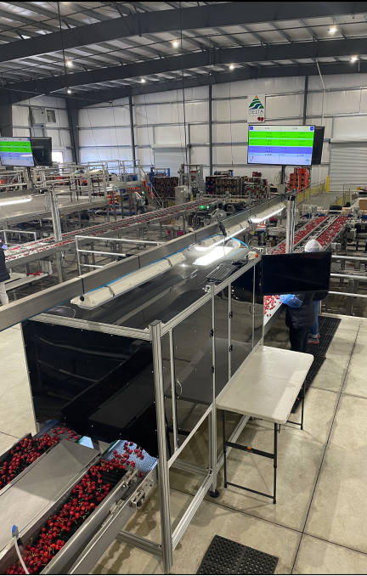
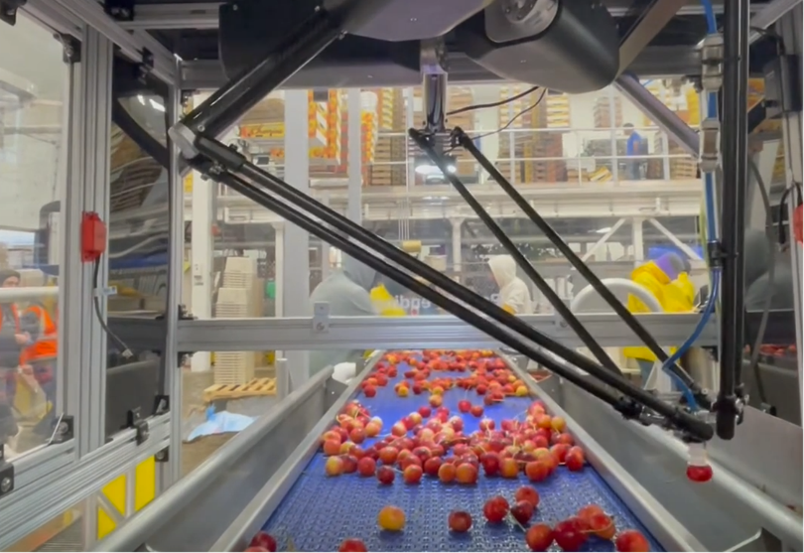
Cherry Defect Sorting

Slide 13
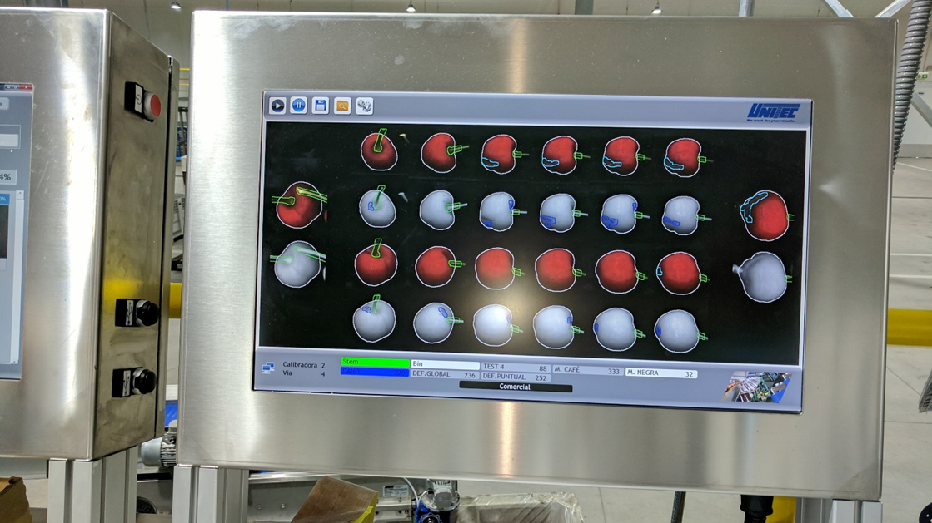

Slide 14
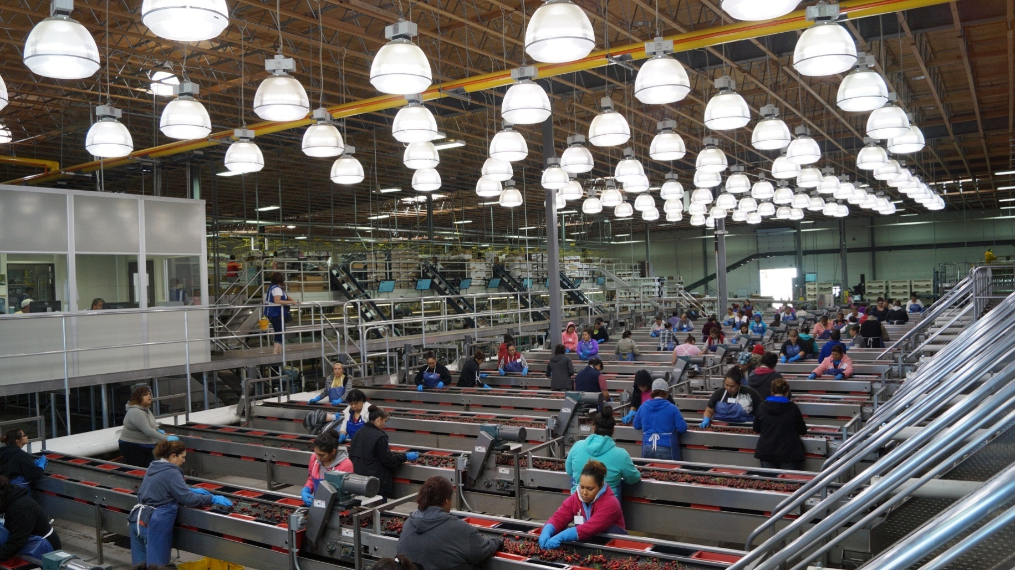

Slide 15

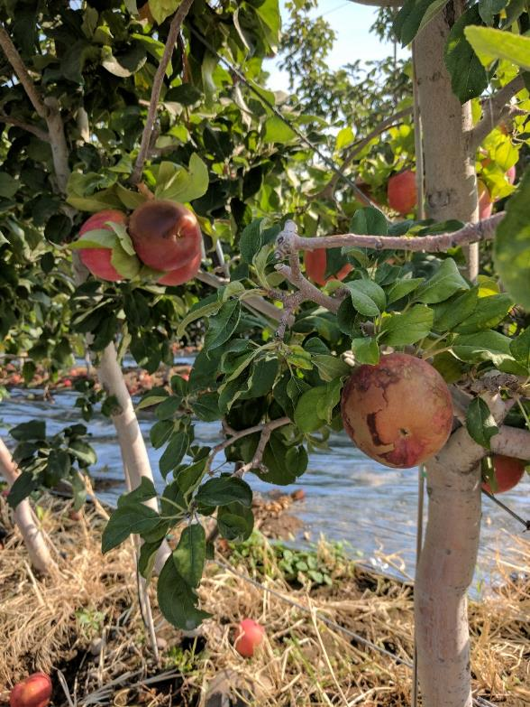
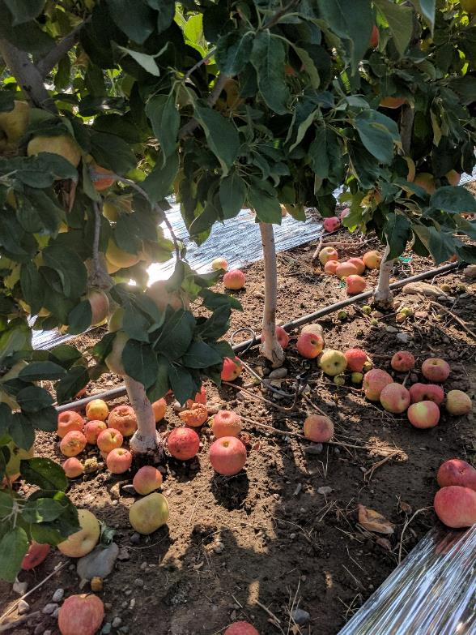
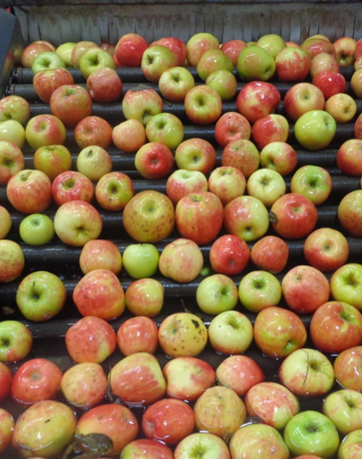
Accurate cull data?
On tree
In orchard
After storage

Slide 16
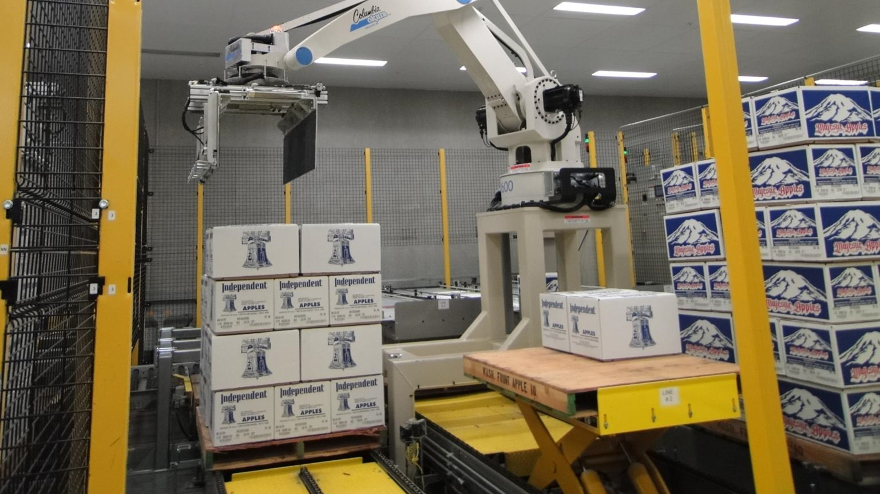

Slide 17
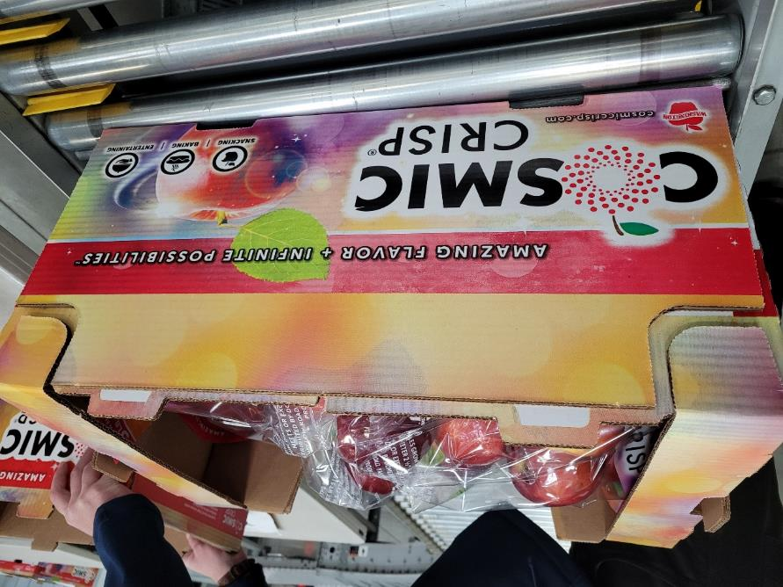
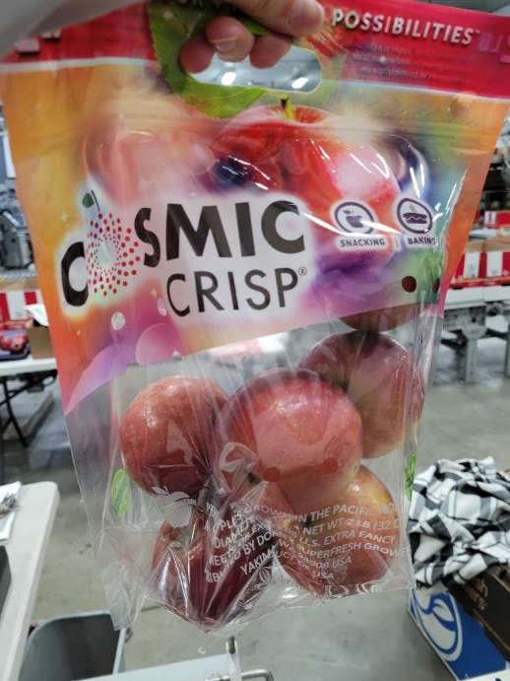
Avoid Re-pack

Slide 18


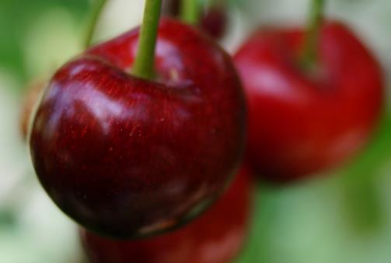
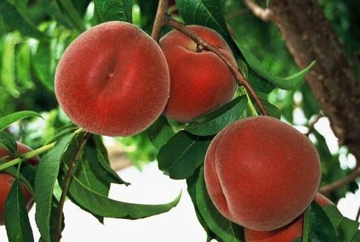
Food Safety
Once introduced, pathogens are difficult to remove
  We have no kill step!!!
  Hurdle approach
Notes:
Also mention maturity and variety

Slide 19

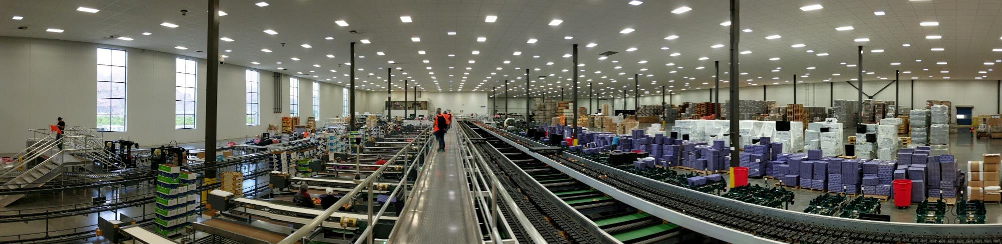
Food Safety wishlist new Packingline
Drains accessible for cleaning
Good lighting
High ceiling
Adequate handwashing facilities
Clean-in-place equipment
Adequate water supply
Make it easy to do the right thing

Slide 20
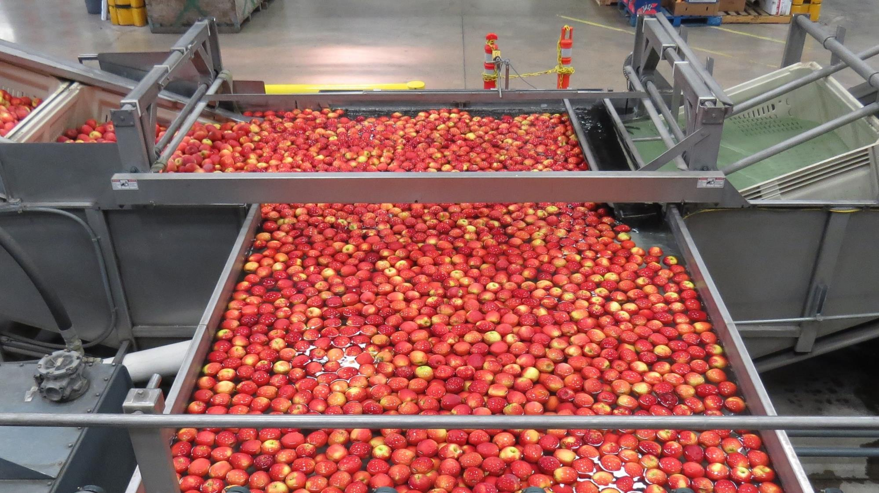

Source: Johannes Goetz
Notes:
hurdle approach: dump tank

