Slide 1
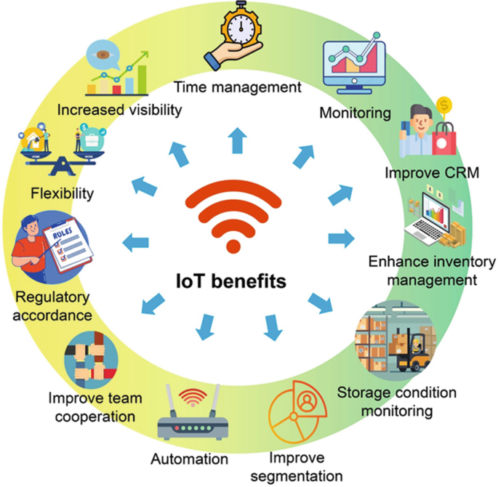
AI in Food Supply Chain Management
Growing with AI: AI for Post-Harvest
Shyam Sablani
Professor of Food Engineering Washington State University

Slide 2
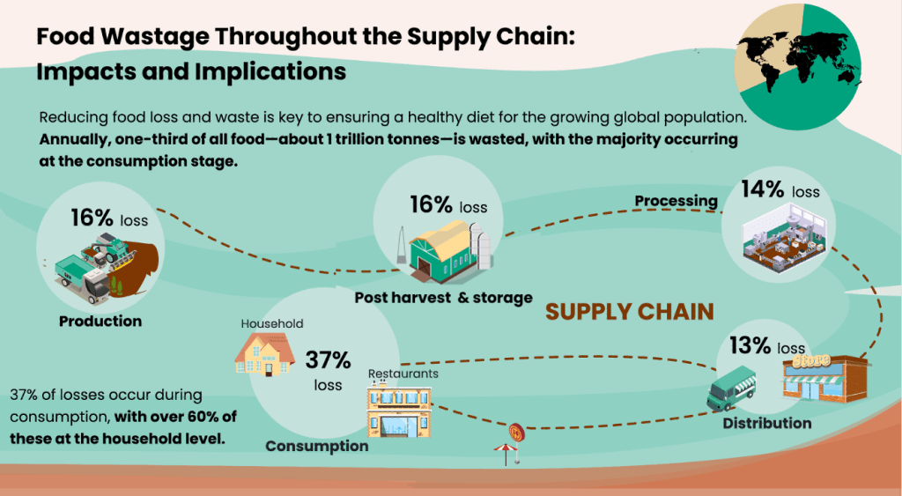
Supply Chain Issues Cause Large Post-Harvest Losses
Notes:
Suggest blowing up picture to make it easy to see. Can say the bullets without putting them on slide:
The supply chain plays a vital role in delivering foods
Supply chains increase the risk of food losses – temperature-sensitive foods, e.g., fresh produce, poultry, meat, fish
Important – Growers facing challenges with water, weather, and labor

Slide 3
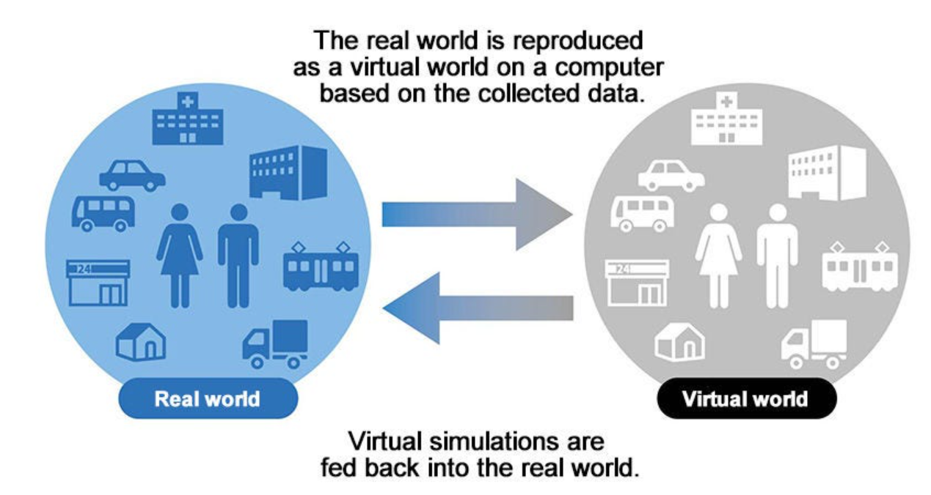
Digital Twin: An AI+IoT tool for Food Supply Chain Management
Digital Twin = A virtual replica
IoT: GPS, RFID, mobile sensors, wireless connectivity
Enable the collection of large volumes of real-time data, supporting big data analytics and artificial intelligence (AI)
Continuous monitoring and analysis of agricultural and food product flow from farm to retail store
Predict remaining shelf life – inventory management
Contribute to the development of a traceability framework

Slide 4
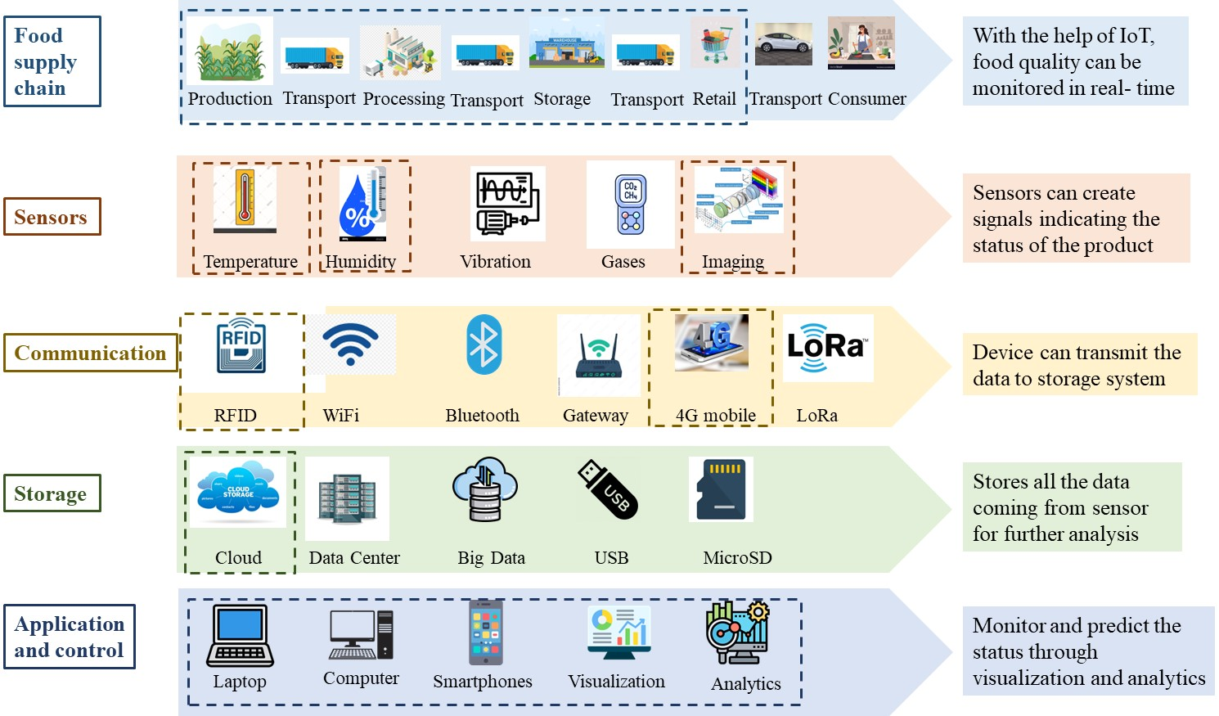
Digital Twin – Framework

Slide 5
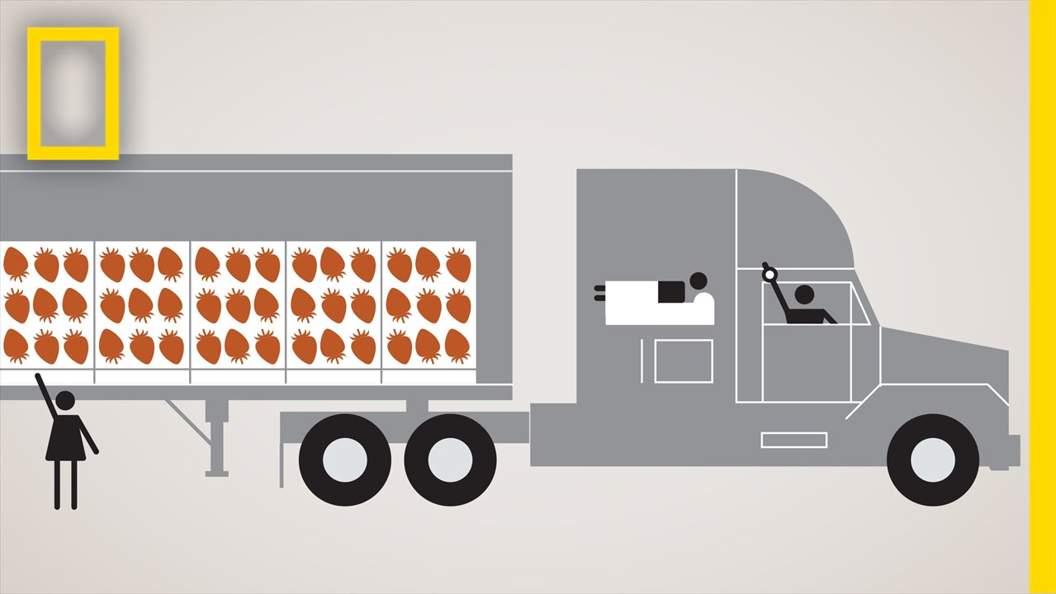
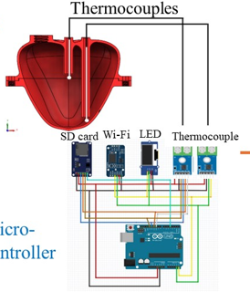
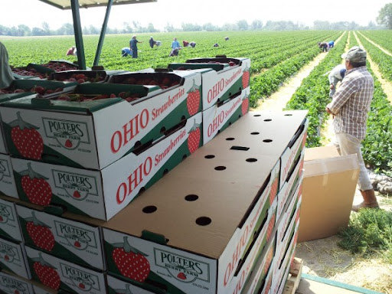


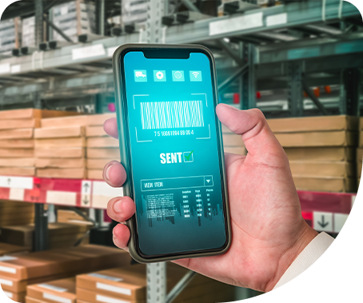
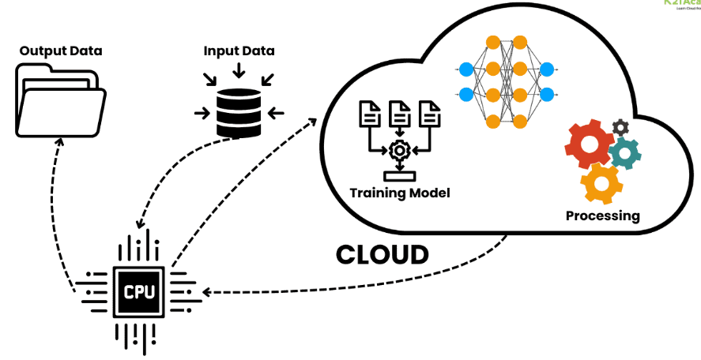
Fresh produce supply chain
Temperature sensor and microcontroller
Biophysical model of a fruit
Combined machine intelligence and human insight - Inventory management
Food quality degradation models
Estimation of remaining shelf-life

Slide 6
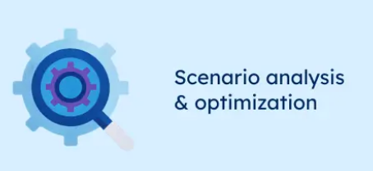
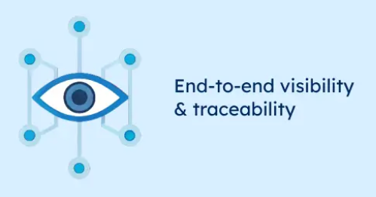
Benefits of supply chain digital twins
Adjusting temperature settings, humidity levels, or airflow rates during transportation or storage can be made to maximize produce quality and minimize quality changes
Transport delays, environmental effects
Transactional data: product specification, transport line, in-transit warehouses, refrigerated truck details, truck driver ID, weather

Slide 7
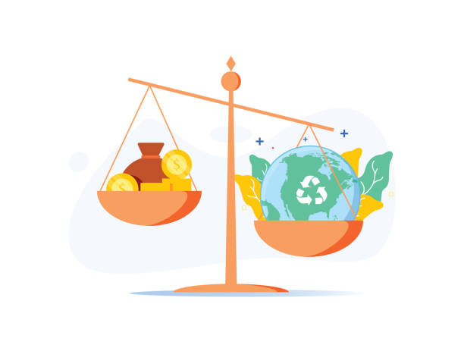
Economic and environmental considerations
Initial investment: Sensors (IoT), connectivity infrastructure, cloud computing, food quality degradation models, and system integration
Maintenance costs: Data storage, calibration of sensors, system upgrades, cybersecurity protection, and skilled technical staff
Typical ROI timeframe - 1–3 years
Food waste reduction: improved storage management
Energy demand of data infrastructure
Electronic waste

Slide 8
Risks/Challenges | Opportunities
Poor data quality → inaccurate predictions | Optimization of postharvest logistics
Ownership and control of data | Training needs (e.g., Digital literacy)
Upfront costs | Shared digital twin platforms
Cybersecurity threats affecting supply-chain operations | Public–private partnerships providing subsidized training and infrastructure

Slide 9
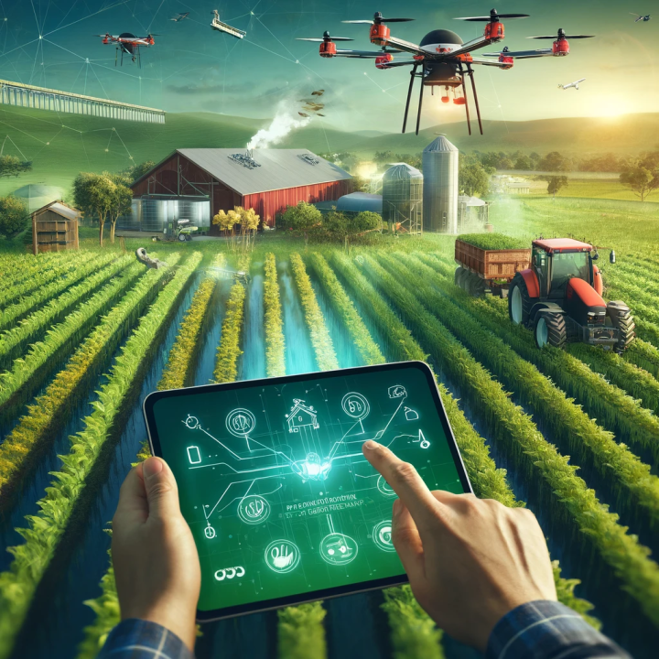
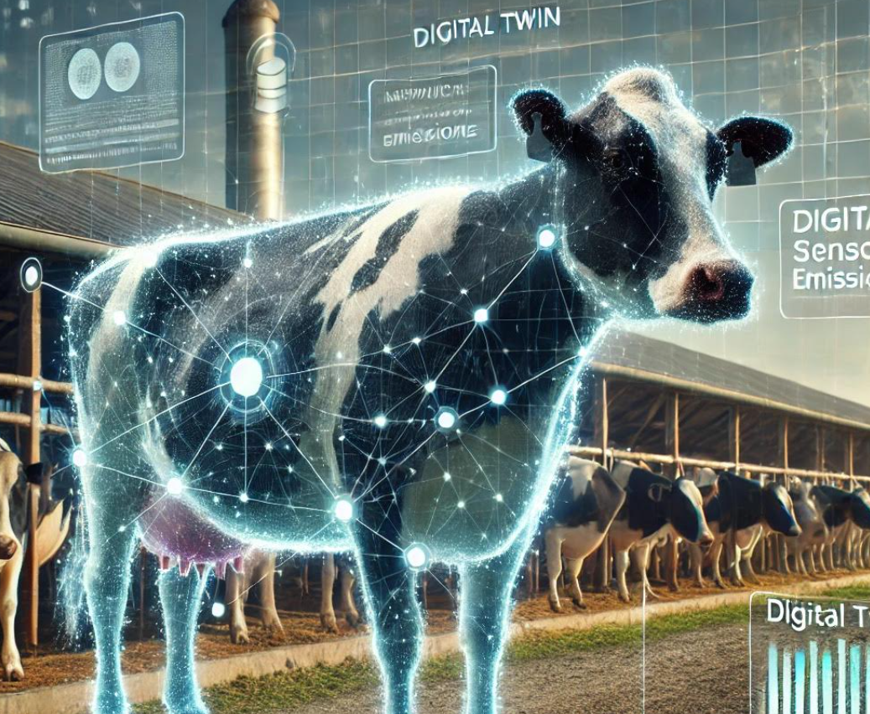
Other uses of Digital twins in agriculture
Digital Field: How different crops will grow based on current soil conditions, nitrogen levels, and predicted weather.
Digital Cow: How a change in activity or spike in temperature (IoT collars or ear tags) can signal animal health; how feed composition affects methane production; and how manure management methods can affect methane capture.

Slide 10



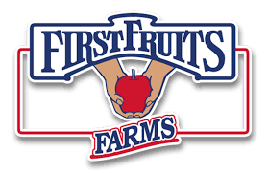


Our team

