Slide 1
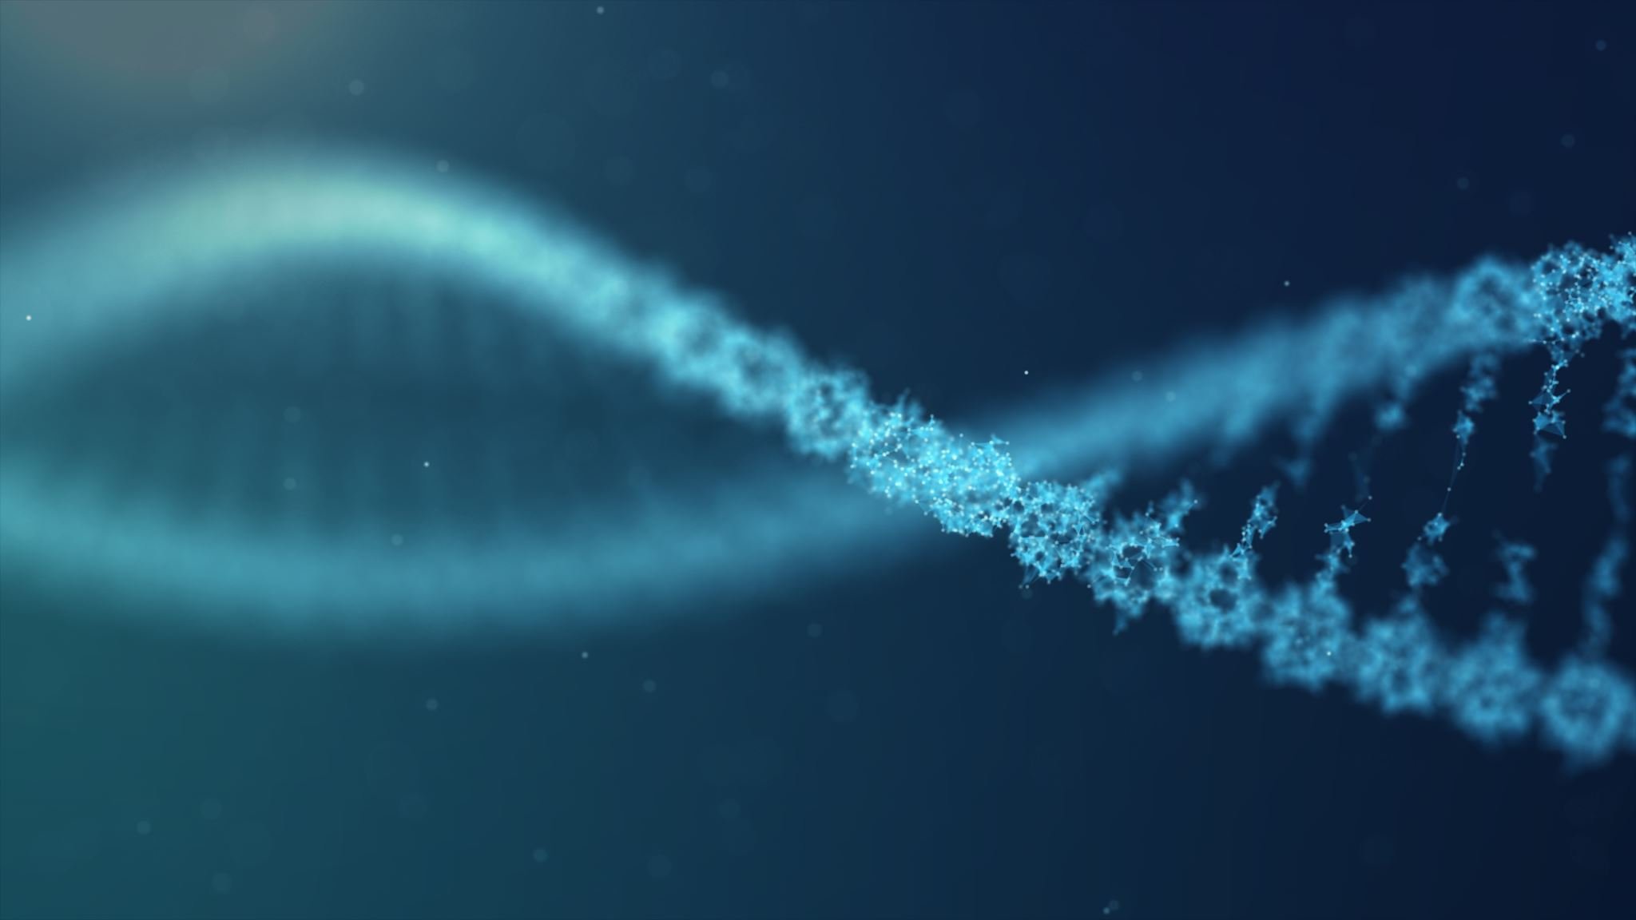
T-STM: Novel Individualized Immunotherapy - Spatio Temporal Modeling of the Triple Negative Breast Cancer Tumor-microenvironment for In-Silico testing of immunomodulatory Drug combinations for enhanced Immunotherapy
Ajeet S Venkatesh
Nikola Tesla Stem High School, Redmond, WA , USA
CBIO054
All images, photos, graphs, data tables and figures were created by the finalist unless otherwise noted.
Notes:
Hello , I am Ajeet Venkatesh and would love to talk to you about my project T-STM for Novel Individualized Immunotherapy testing

Slide 2
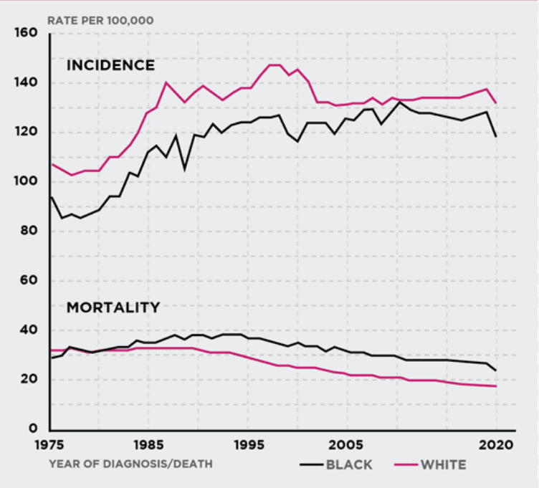
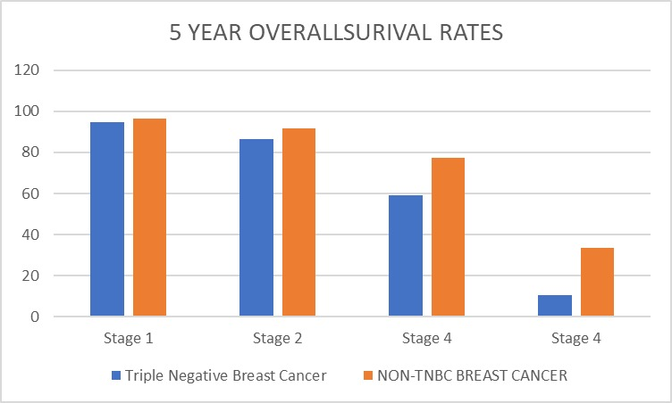
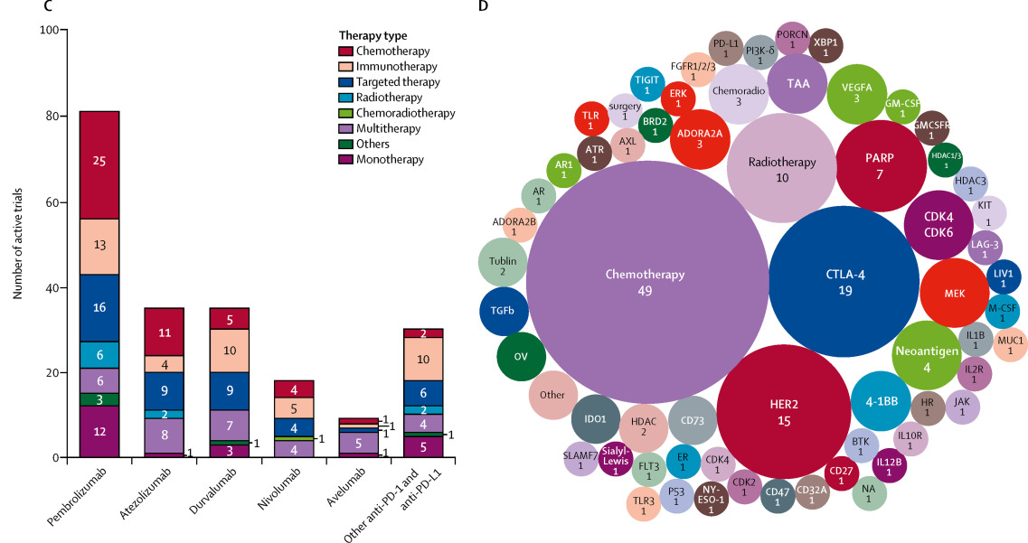
Triple Negative Breast Cancer -Challenges
Breast Cancer
670,000 deaths
TRIPLE NEGATIVE BREAST CANCER
10-20% cases
Lack of targetable receptors(ER,PR,HER)
Mortality
Incidence
Early metastasis
2.3 Million diagnosed
Aggressive cancer
Cancer Immunotherapy
Incidence vs Mortality Rate
Great Remission rates
Problem:
Effective only in 20-30% cases
Pembrolizumab Trial for PD-1 :FDA approved 2021 (Schmid et al.)
Introduction
Susan G. Komen
Stagewise Survival Rates Hsu et al.
Heterogeneity in Tumor-microenvironment
Cellular Heterogeneity: genetics ,epigenetics ,phenotypic variations → growth rates, invasiveness, metastatic potential
Dynamic Immune evasion
Multiple Immunosuppressive pathways and proteins in TME
Molecular Heterogeneity: Mutations lead to diverse molecular profiles
Functional Heterogeneity: Different metabolic pathways, Spatial heterogeneity due to nutrient availability
Up-regulation of alternative checkpoints
Complex Tumor-microenvironment
Current drug testing methods unable to account for Dynamic interaction of cancer ,immune cells, signaling molecules, extracellular matrix components.
No mechanism to account for Patient specific variability
Down-regulation of targeted checkpoints or antigen presentation and
Limitations in Current Therapies
Immunotherapy and targeted therapy combinations in metastatic breast cancer (Esteva et al.)
NEED : Efficient mechanism to simulate the complex cell interactions in the Tumor microenvironment for effective individualized immunomodulatory combination therapy targets identification
Notes:
Can you believe that in spite of decades of research and progress, breast cancer was the cause for 670 thousands deaths in 2022 alone affecting 2.3 million women globally? Personally, I have seen the debilitating effects of the rounds of chemo on my piano teacher who has been struggling with TNBC for years. Triple-negative-breast-cancer is a highly invasive form which is difficult to treat due to lack of targetable receptors. Hence it has a poor prognosis with the 5 year survival rate for metastatic tnbc being around 12%.
Immunotherapy treatments that rejuvenates the body’s own immune system to kill tumor cells is a potential treatment option in TNBC because of its high mutation rate and neoantigens but is effective only in 25% patients.
This is because “one drug fits all approach” fails to account for multiple immunosuppressive mechanisms in the Tumor microenvironment.
Current drug development methods don’t account for tumor heterogeneity and the dynamic interaction between the cancer cells, immune cells and signaling molecules which can change in space and time in response to resources, stresses and mutations .They also don’t account for patient specific variations in cellular ,molecular and functional heterogeneity arising from epigenetics, or genetic mutations leading to diverse transcriptomics, molecular profiles and cellular signaling that can drastically affect immune evasion through multiple immunosuppressive pathways.
There is a dire need for an Efficient mechanism to simulate the dynamic , heterogenous Tumor microenvironment with its immunosuppressive pathways for effective individualized in-silico drug testing.

Slide 3
Research Question and Engineering Goals
Research Question
Can the behavior and interactions of tumor , immune, stromal cells and other growth factors and metabolites in the TNBC Tumor-microenvironment be modeled spatially and temporally to simulate the immune response on the tumor cells and identify potential immunosuppressive targets ?
G1: DEVELOP AGENT MODELS
GOAL 1) Develop agent-based models for Tumor cells, Immune cells ,Stromal cells/Fibroblasts in T-STM
G2: MODEL NUTRIENT DIFFUSSION
GOAL 2) Simulate nutrients diffusion from blood vessels in T-STM using Partial differential equations
GOAL 3) Model immunosuppressive mechanisms of Kynurenine, AKT mTor and Jak/STAT pathway in T-STM
G3: MODEL IMMUNO-SUPPRESSIVE PATHWAYS
G6 : INHIBITOR IDENTIFICATION
G4 : SPATIO TEMPORAL VISUALIZATION OF CELLS IN TME
GOAL 6) Identify combination of inhibitors for tumor cell reduction of various molecular subtypes of TNBC
GOAL 4) Develop gifs to visualize Spatio-temporal visuals of tumor, stromal and immune cells to understand probabilistic behavior
G5: TEMPORAL PLOTS
GOAL 5) Develop time plots of tumor, stromal and immune cell counts for analysis and validation
Introduction
Notes:
So I created T-STM , the first of its kind multi-agent, Spatio-temporal-model that simulates the TNBC TME for identification of unique individualized combination therapies or inhibitors for each TNBC case based on the transcriptomics.

Slide 4
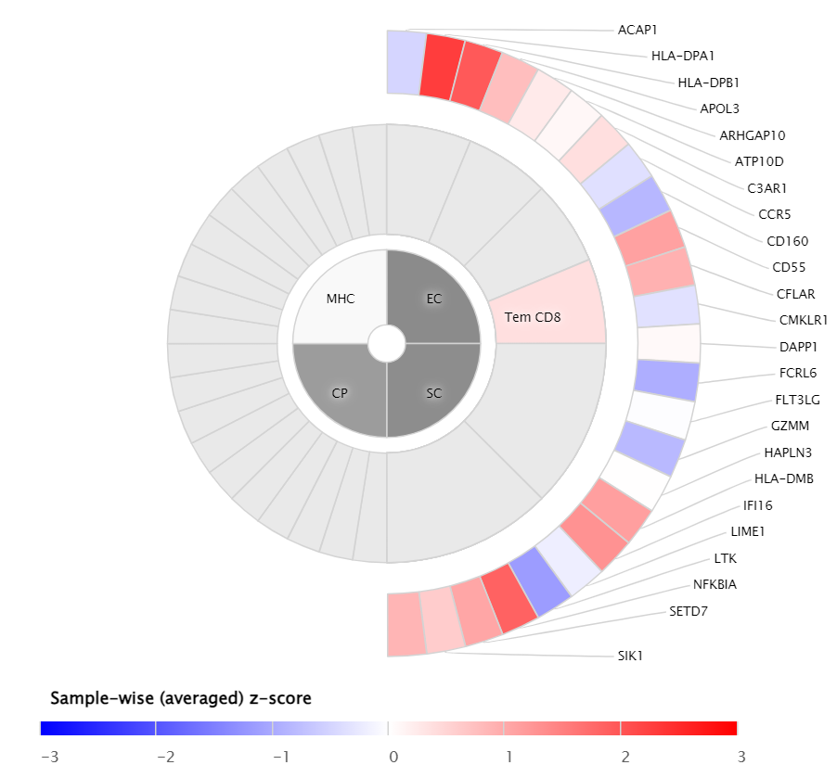
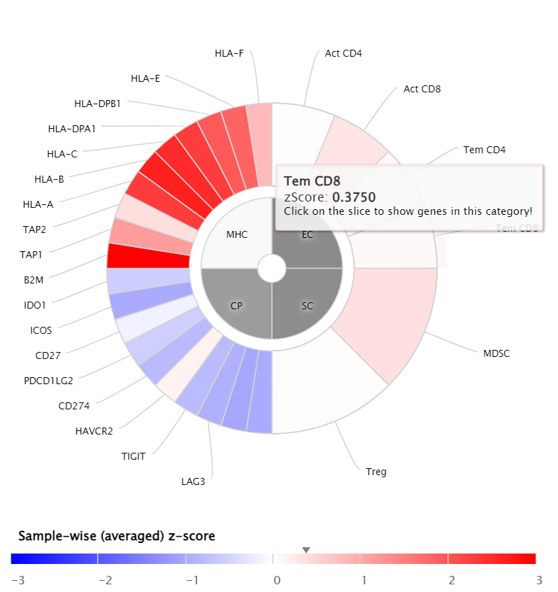
T-STM DESIGN
Breast Cancer TME
Agent Based Model -Tumor , CAFs, Immune cells
Partial Differential Equations Nutrient Diffusion model
Modeling Kynurenine, Jak/STAT ,Pkt mTOR pathways
Proteomics TCGA Breast cancer Data + Immunomodulators Gene expression data from TCGA
(Charoentong et al., 2017)
Methodology
Tumor , Patient specific Parameters :
Neoantigens (resulting from mutation),
CGAs(Cancer Germline antigens -aberrant in tumor cells)
Checkpoints, adjuvanticity, Cell fractions,
Immunosuppressants and Effector proteins
UNIQUE HYBRID DESIGN
FIRST –EVER SIMULATION OF TNBC TME with dynamic tumor immune interactions.
DATA DRIVEN approach using high-throughput sequencing and transcriptomic data to model characteristics of a real TME
DISCRETE AGENT BASED MODEL coupled with
CONTINOUS PARTIAL DIFFERENTIAL EQUATIONS-based model with
(Charoentong et al., 2017)
AGENT BASED MODELING
NUTRIENT MODELING
UNIQUE HYBRID DESIGN
IMMUNO-SUPPRESSIVE PATHWAYS
IMMUNO-MODULATION
Notes:
T-STM uses a novel hybrid approach with
discrete agent models to characterize tumor, stromal and immune cells behavior and interaction ,
Continuous partial-differential-equations for modeling nutrient diffusion or resource availability and
mass action kinetics or Michelis Mentin equations for modeling immunosuppressive pathways in the TME .
It then incorporates transcriptomic data from The-Cancer-Genome-Atlas to characterize tumor and patient-specific metabolic variables in the agent models such as tumor mutational burden, antigenicity, checkpoints , and immune infiltration patterns.
This data driven approach models characteristics of real TME.

Slide 5
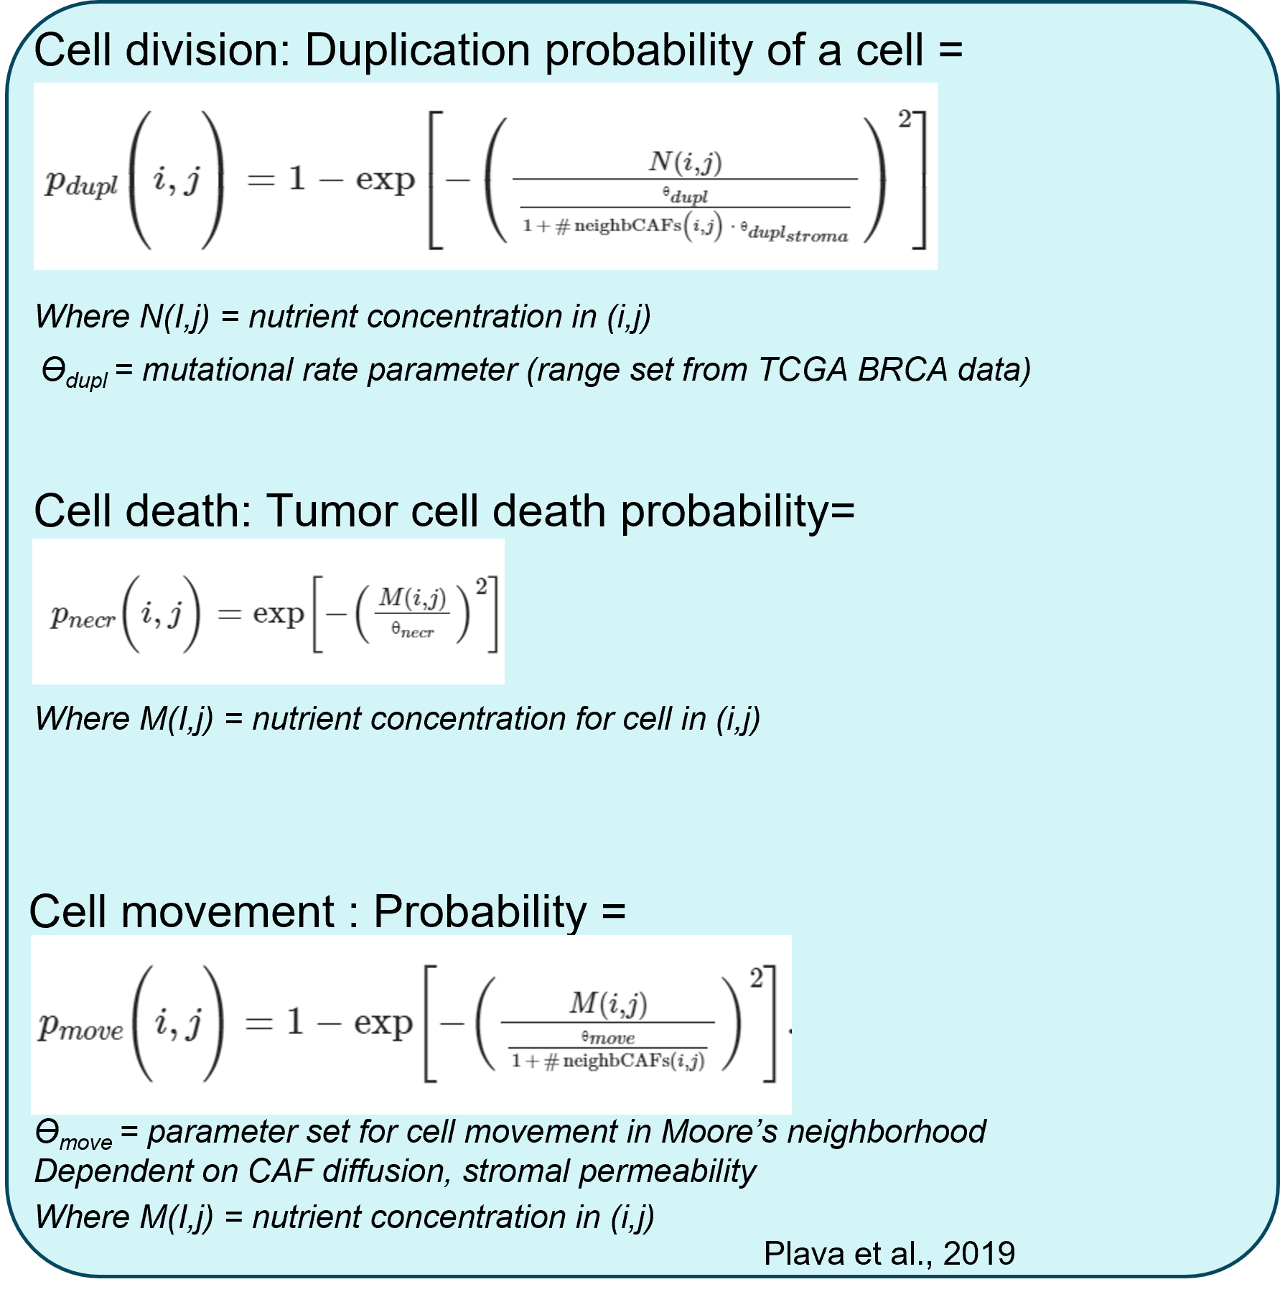
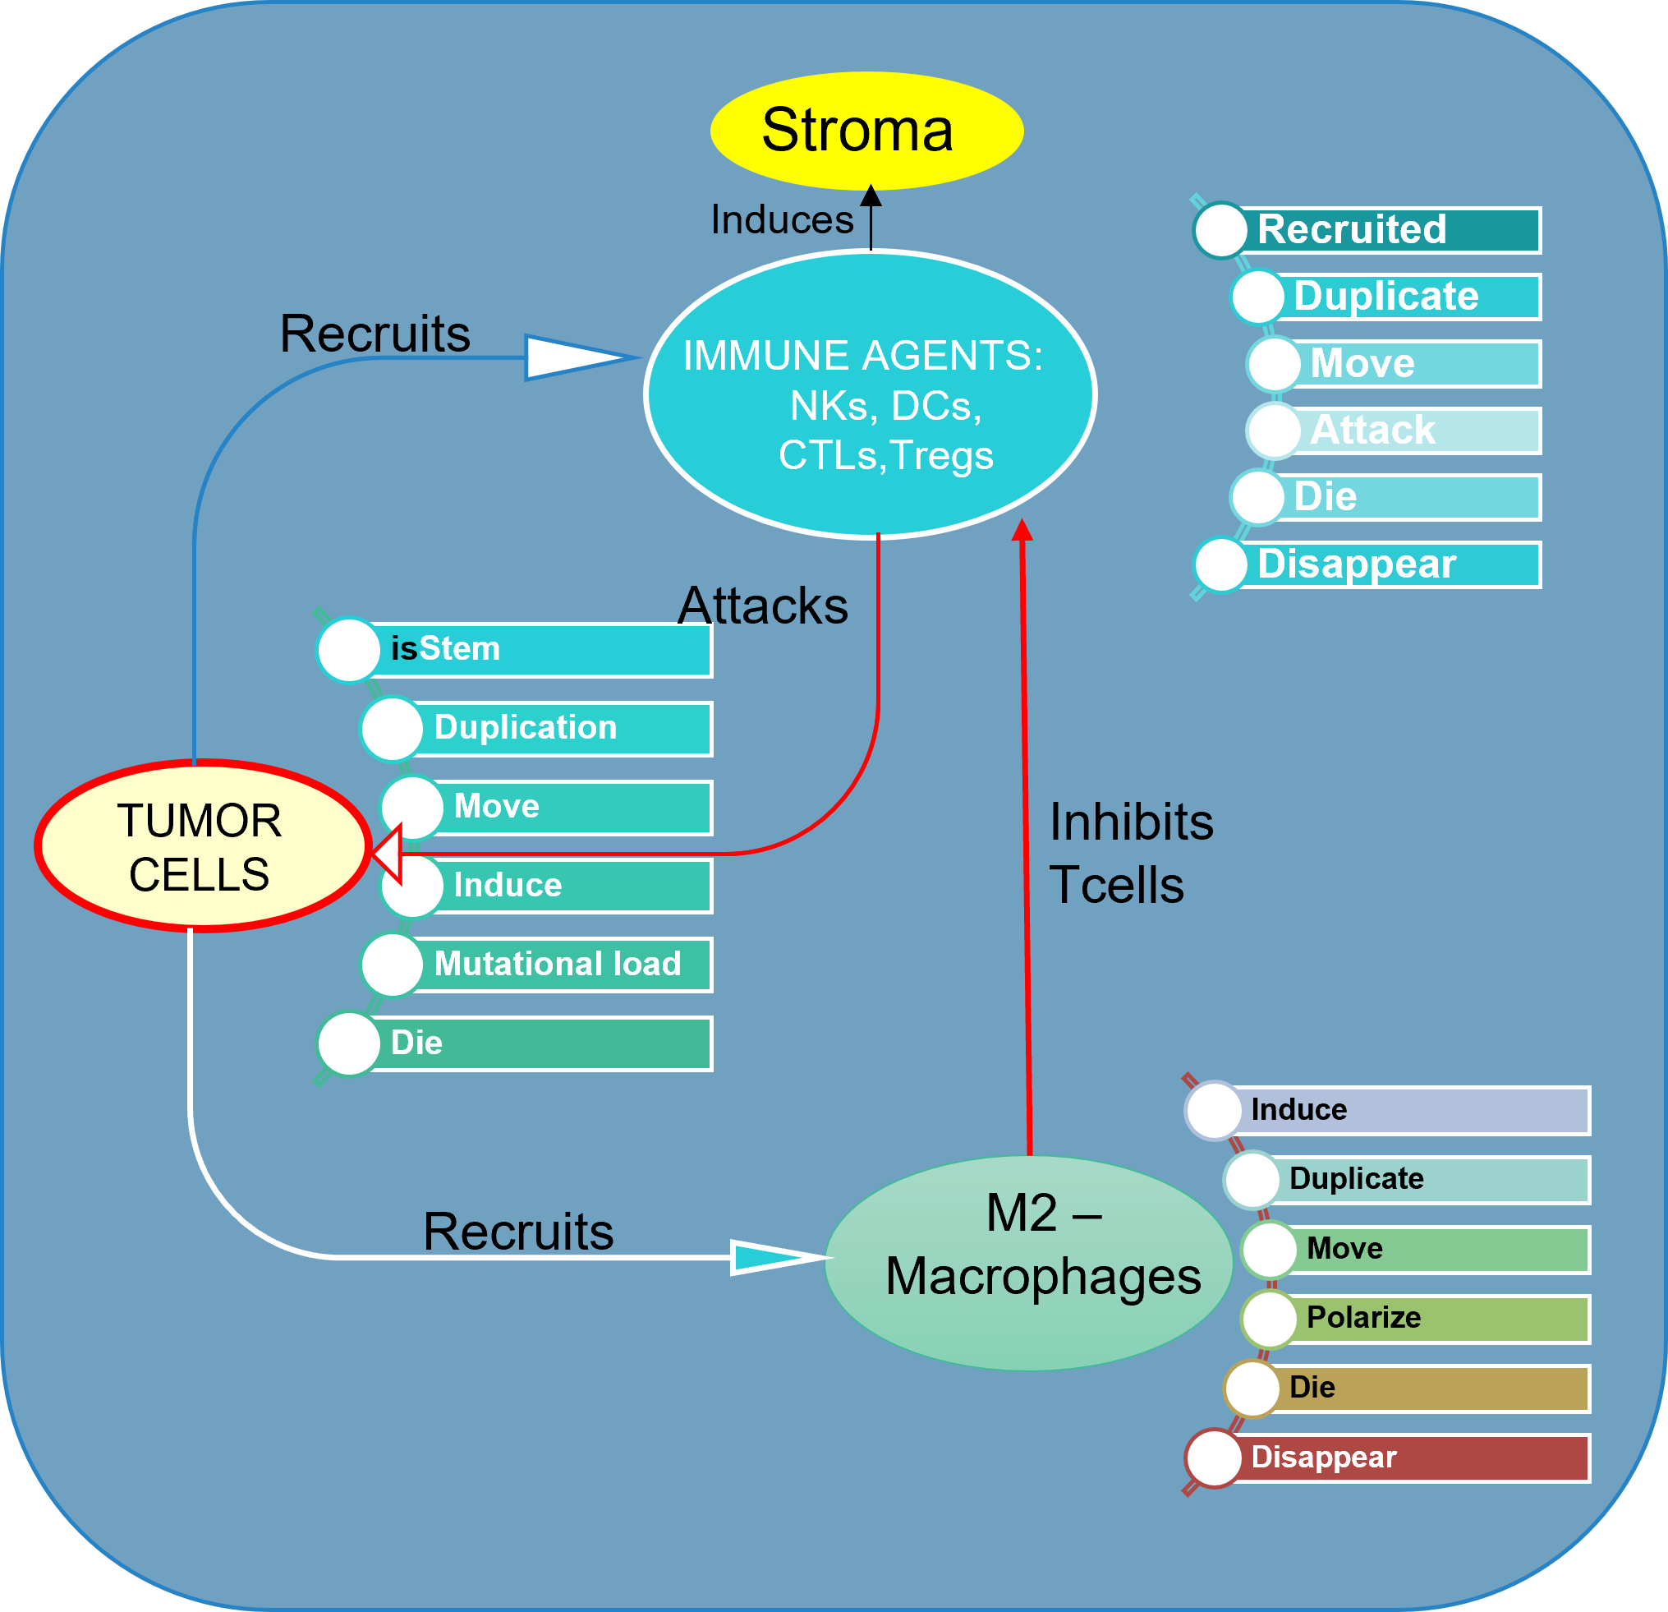
T-STM AGENT MODEL DESIGN
AGET MODELS
Methodology
N –nutrients necessary for cell division
ϴ_{necr} = necrosis parameter (calculated from mutational status)
M –nutrients necessary for cell survival
AGENT IMPLEMENTATION

Slide 6
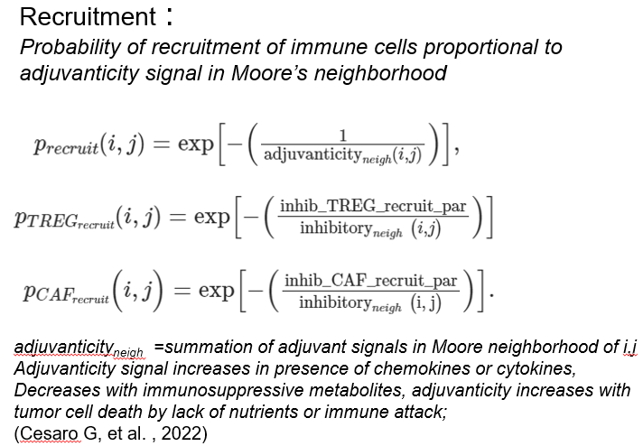
T-STM AGENT MODEL DESIGN
AGET MODELS
Specialized Agent specific behavior modeled in T-STM
CANCER AGENTS
Accumulate mutations resulting :
(2) loss of immunogenicity through inhibitory immune checkpoint molecules(LAG3, PDL1,TIGIT etc.)
(3) release immunosuppressive signaling molecules & increased or decreased duplication/survival
1)loss or acquisition of antigenicity or new antigens
CAFS
Efferent mechanism: cancer cells trigger a response in the stroma,
IMMUNE AGENTS
NKs, CTLs (CD4, CD8), Dendritic Cells(DCs) and immunosuppressive Tregs
Macrophages polarize from Immune effector M1 to immune suppressive M2
Treg recruitment : when a CTL becomes inactive or immunosuppressive pathway
CTLS
Adjuvanticity parameter : Increases with chemokines , decreases with Tregs /Metabol
Antigen specificity of CTLs: CTLs attack only when specific antigens are recognized .
Parameter degree of permeability- TILs infiltration, tumor cell movement
Afferent mechanism : Activated CAFs affect proliferation
CTLs killing probability lowered when tumor acquires checkpoint mutation -PDL1/ LAG3
Antigen-specific T cells recruited if recognized or delayed, so to mimic their activation in the lymph nodes.
Methodology
Notes:
Patient specific real tumor micro environment data are incorporated as parameters in the models and used in the equations

Slide 7
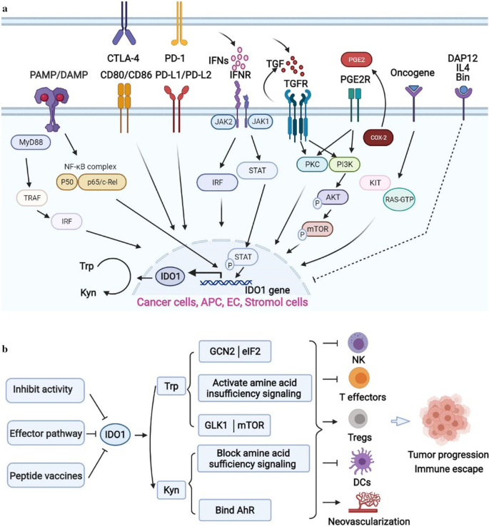
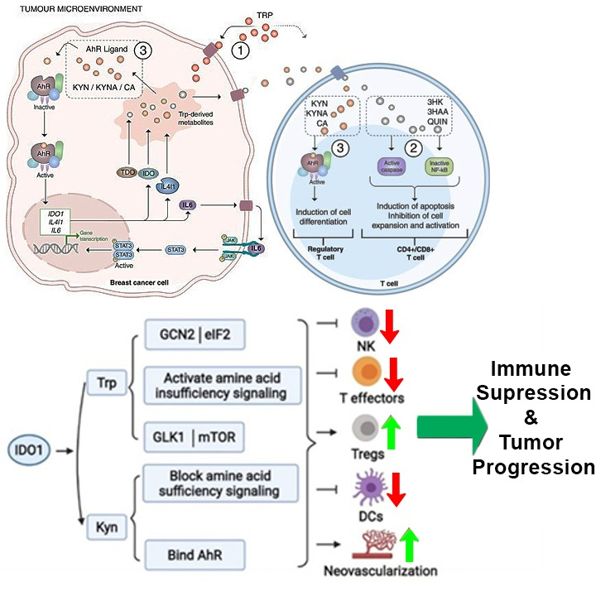
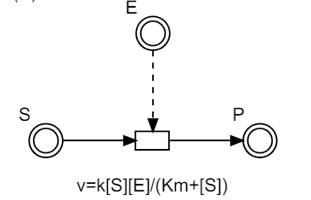
T-STM - Immunosuppressive pathways design
Nutrient Diffusion using Partial differential equations:
Where D_{c} is the nutrient diffusion coefficient , I(x,y,t) and T(x,y,t) are the spatial distributions of Immune agents and Tumor agents at time t and Ki and Kt are respective consumption rates.
Biological Pathways Modeling
Mass Action Kinetics for Signaling Pathway Equations with no protein transformations
Michaelis Menten - Protein modification equations
Methodology
(Liu, 2005)
(Liu, 2005)
Example : [STAT3 → STAT3_p] phosphorylation equation of STAT3 by EFGR activated JAK1/JAK2 complex with activator A and inhibitors Inh1 and Inh2, shown in the diagram on the left, flux equation is: (Vf_A_appr * STAT3 concentration) /( Km_STAT3 + STAT3.concentration).
Vf_A_appr = Vf A / {1 + (Inh1 /Ki_Inh1)+(Inh2 /Ki_Inh2)}
where,Vf : rate of the reaction = Kcat (turn over number of the activator driving the reaction) * concentration of activator ; Km : affinity of the substrate (low Km indicating a high affinity).
Ki : concentration of the inhibitor required to inhibit the reaction by 50%.
(Pingle et. al, 2014)
Immunosuppressive Kynurenine, mTor Pathways
Modified from (Girithar et. al,2023) and (Tang et al., 2021)
Notes:
Immunonosuppressive K , mtor and STAT pathways are modeled with 50 differential equations using Mass action kinetics for reactions with no protein modifications and Michelis mentin equations for protein modifications.

Slide 8
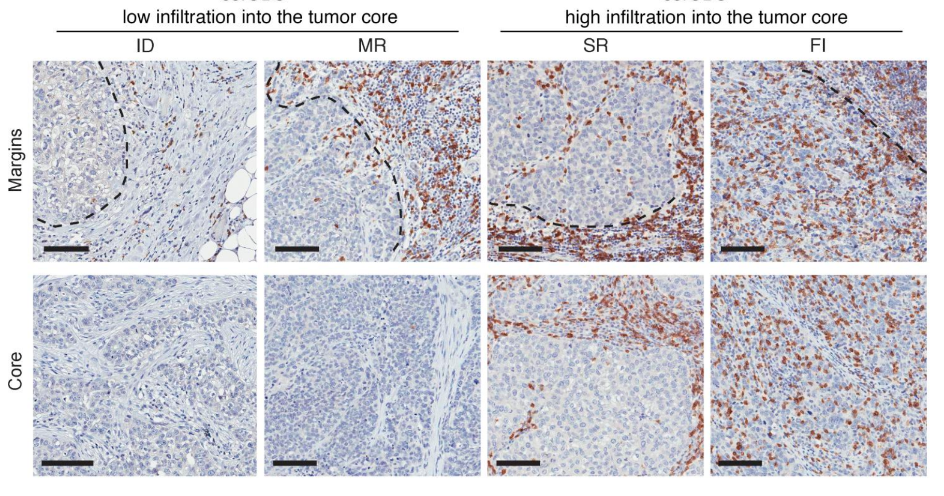
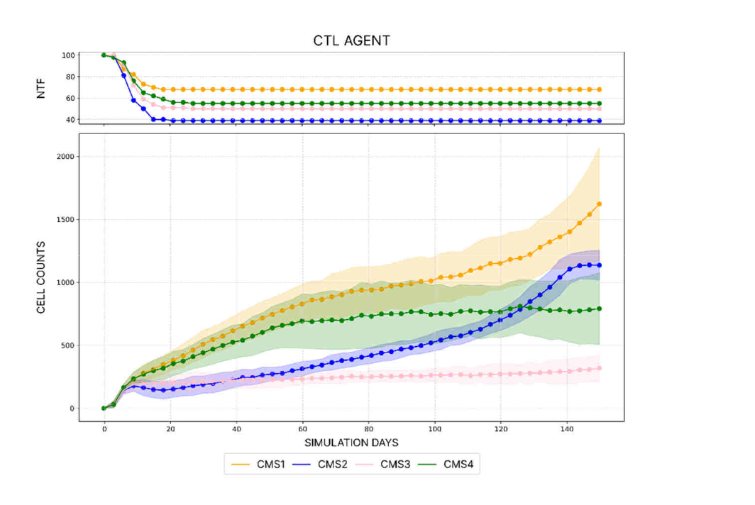
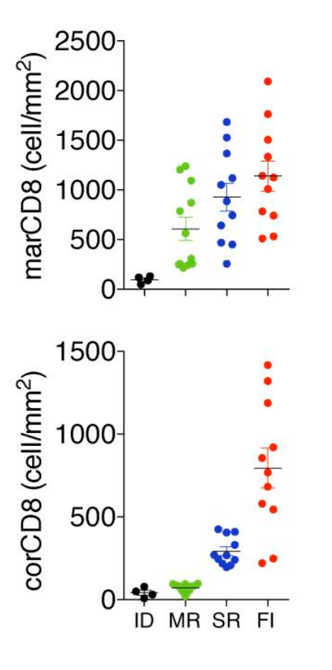
T-STM VALIDATION: Histopathological correlation with 4 immune subtypes of tnbc tme
Results, Discussion
Cardinality of CTL cells over time for ID,MR,SR and FI .
Upper subgraph : number of NTF(non-tumor free) simulations
Lower subgraph: Avg # of CTLs computed across all NTF simulations of given TIME group
shaded area : variability (± standard deviation),
Quantification of CD8⁺ T cell densities at the tumor margins (marCD8) and in the tumor core (corCD8) (n = 38) from (Gruosso et al., 2019) .
(Gruosso et al., 2019) .
T-STM in-silico simulations of the four TIME subtypes(Tumor immune microenvironments ).
Left panels -Temporal evolution of 100 simulations; Upper histogram: Number of not completely tumor-free (NTF) simulations on that day , i.e. simulations having at least one cancer cell in the domain. Lower temporal graph: Time course of cell-counts across NTF simulations in log10-scale:
Middle panels- Spatio-temporal evolution of one simulation for each ID, MR, SR, FI TIME subtypes across 60,90,120,150 days.
Right Panel: Images of CD8⁺ T cell staining at the tumor margins (top panels, dotted lines) and in the tumor core (bottom panels) (n = 38). Scale bars: 100 μm
Clinical Significance : T-STM ran simulations on 38 datasets and successfully reproduced the 4 Tumor microenvironment immune phenotypes of the TNBC TME - Immune desert(ID), Margin restricted (MR),Stromal restricted (SR) and Fully inflamed(FI), validating an in-silico simulation platform that can be used for inhibitor tests. Immune phenotype classification based on CD8+ T cell localization described in (Gruosso et al., 2019)
Notes:
Simulation results were successfully validated with histopathological matching with 4 immune phenotypes as shown here –
Immune desert,
Margin restricted ,
Stromal restricted and
Fully inflamed.
Results showed high correlation between the cell count plots on the right top as compared with the bubble plots below independently generated from tcga patient data.

Slide 9
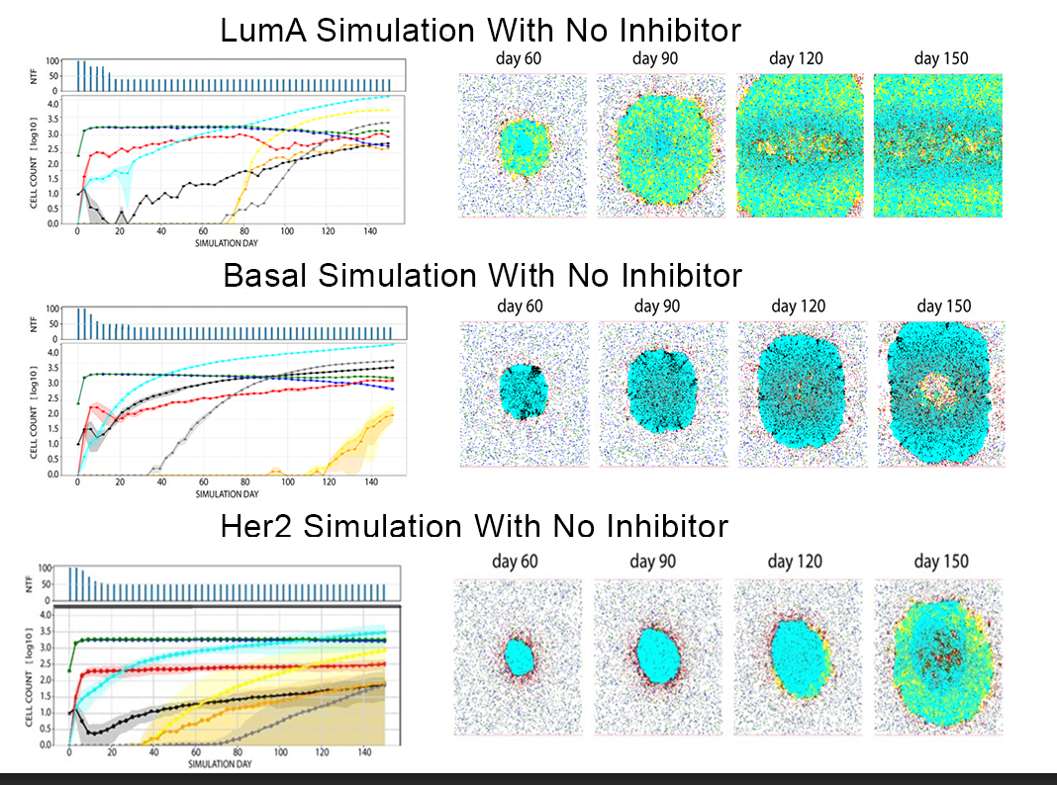
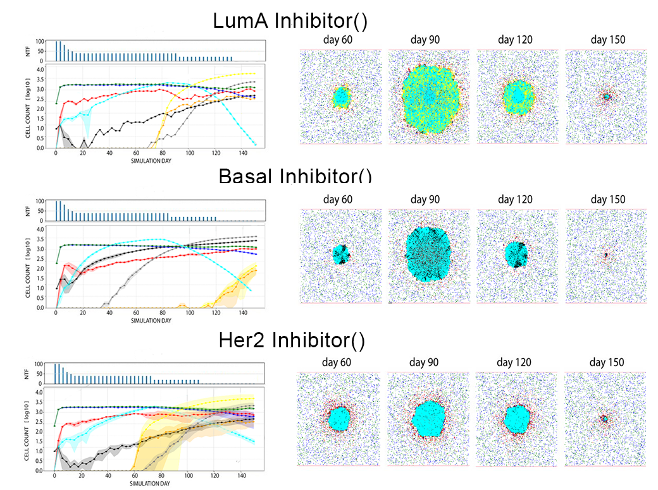
T-STM in-silico testing: inhibitor combinations for tnbc molecular subtypes
Inhibitor combinations (low, mid, high concentrations)
Results, Discussion
T-STM in-silico simulations of the TNBC molecular subtypes; Left panels -Temporal evolution of 100 simulations; Upper histogram: Number of not completely tumor-free (NTF) simulations on that day ;Lower temporal graph: Time course of cell-counts across NTF simulations in log10-scale:
Right panels- Spatio-temporal evolution of one simulation across 60,90,120,150 days.
Simulation Details:
Input : TCGA TNBC patient data (n=30) for each of molecular subtypes –Basal like, Luminal A , Luminal B,Her2 immunomodulatory molecular subtype datasets
Ran 30 simulations of each inhibitor individually and in combination for 150 days or until tumor free for each dataset
Best Representative results plot shown for each molecular subtype
Lum A : Tlr9 (Tol like receptor 9 agonist) immunostimulant + AR inhibitor + PDL1 blockade
Basal : PDL1+LAG3+ IDO1 inhibitor +p13K inhibitor
HER2 : Tlr9 (Tol like receptor 9 agonist) immunostimulant + mTOR inhibitor + LAG3 blockade + PDL1 blockade
Lum A: PDL1 inhibitors + Kynu inhibitor
Her2: IDO1 inhibitor + PDL1 inhibitor
Immunomodulatory: PDL1 + LAG 3 blockade + IDO1 inhibitor
Lum B : LAG3 blockade +IDO1 inhibitor+ PDL1 blockade + p13K inhibitor
Basal 2: IDO1 + LAG3 inhibitor
Basal 1: IDO1 + PDL1 blockade
Control
Median
Clinical Significance : Checkpoint blockades like LAG3 inhibitors + IDO1 inhibitor and TLR9 agonist were novel combination therapies for tumor eradication. Different combinations were efficacious in each TNBC subtype indicating need for custom therapies
Notes:
Simulations run on 100 datasets for 150 days showed best tumor remissions with novel combinations for each of the TNBC molecular subtypes such as P13k and IDO inhibitors combined with LAG3 and PDL1 blockade for basal whereas TLR9 agonist for Lum A and Her2 subtypes which makes sense as they have higher number of polarized immunosuppressive macrophages and TLR9 agonist repolarizes from M2→M1.
Clinically Different combinations were efficacious in each TNBC subtype indicating need for custom therapies which can be identified with T-stm. As it modeled the dynamic heterogeneity of biologically diverse TNBC subtypes .

Slide 10
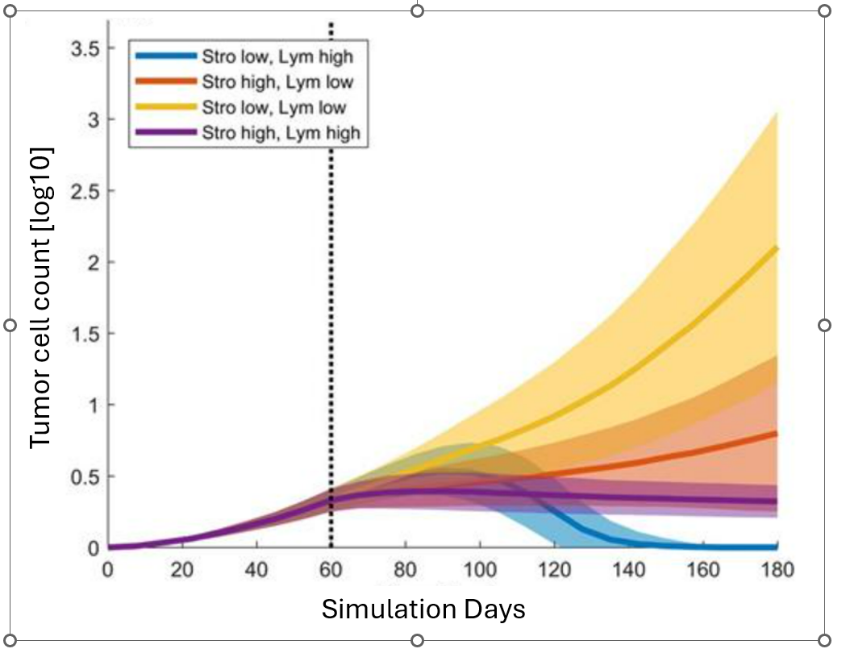
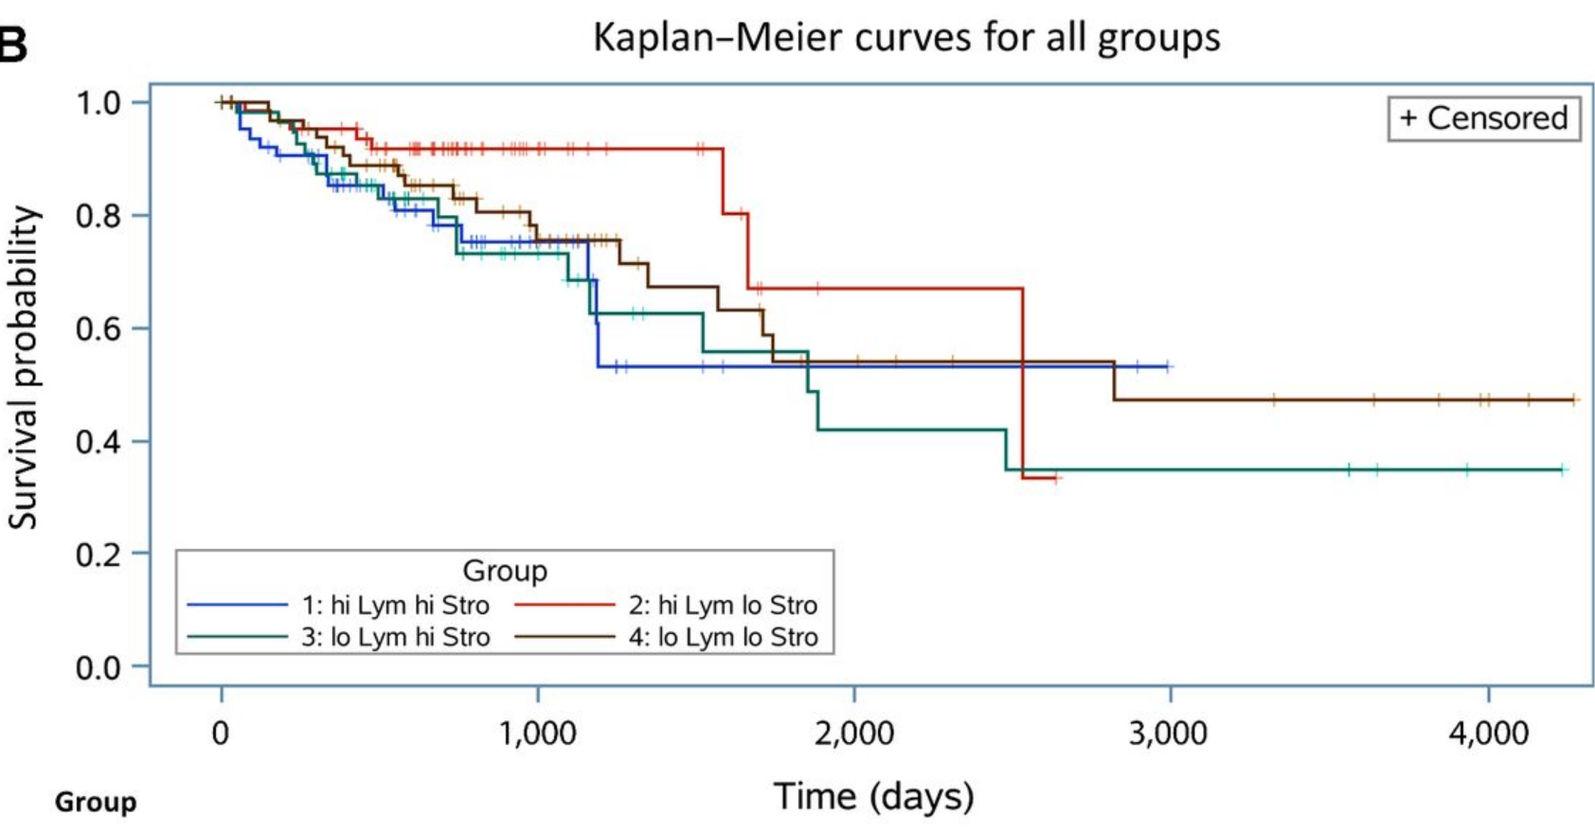
T-STM simulations: effect of STROMAL- t lymphocytes RATIOS on tumor eradication
Simulation Details
Input : TCGA TNBC basal data (n=50)
50 simulations on each dataset
1) Grow tumor for 60 days
2) On day 60, simulated combinations: varying levels of stroma & CAF recruitment vs CTLS (T lymphocytes).
3)Recorded Tumor cell counts
Results, Discussion
(Charoentong et al., 2017b)
Findings :
Stro low, T-Lym low : Unhindered, exponential tumor growth
Stro high, T-Lym low : Restrained tumor growth, as expected
Stro high, T-Lym high : Tumor size constrained to <10,000 cells
Stro low, T-Lym high : Initial increase in tumor mass ,then immune cells inflow completely eradicated tumor in almost all simulation runs.
Complete Remission -most favorable outcome
Simulation results correlate with
Kaplan–Meier survival curves for all groups and
Cox proportional hazards model (hazard ratio 0.309 for overall survival 0.322, P = 0.0219, confidence interval 0.122 to 0.849)
Clinical Significance
Significant finding - shows that stromal permeability can play a key role in immune response and CTL infiltration. Hence
Stroma targeting therapies that increase stromal permeability optimally can be given to ensure increased immune infiltration and drug delivery for effective combination immunotherapy.
Notes:
T-STM simulation experiments with different stromal/T lymphocyte ratios also showed that stromal permeability can play a key role in immune response and CTL infiltration
Tstm shows that Increasing stromal permeability through stromal targeting therapies can produce better immunotherapy as validated by Kaplan–Meier survival curves.
This is clinically significant as it explains why some TNBC cases do not respond to nano-chemotherapy or immunotherapy in spite of having CTls in the TME.

Slide 11
Conclusions
T-STM - novel mechanism to simulate tumor microenvironment dynamics for
In-silico testing potential individualized combination therapies based on the patient’s transcriptomic/proteomic data rather than generalized molecular subtype-based therapy.
First step in customized optimal combination immunotherapy .
Successful Validation
T-STM spatio-temporal gifs showed accurate TCGA histopathological immune phenotypes reproduction
High correlation with cell counts ratios from T-STM simulations for each of the 4 TNBC molecular subtypes with the cell fraction histograms independently derived from TCGA datasets
Identified novel combination inhibitors
Identified best inhibitor combinations for basal ,immunomodulatory, Her2 and Lum A TNBC datasets
Blockades for LAG3 and PDL1 checkpoints along with IDO1 and p13K inhibitors
The Tlr9 agonist showing results in Lum A and Her2 makes sense as they have higher number of polarized immunosuppressive macrophages and TLR9 agonist repolarizes from M2→M1
Significant finding: Stromal permeability can play a key role in immune response and CTL infiltration.
Stroma targeting therapies that increase stromal permeability optimally can be given to ensure increased immune infiltration and drug delivery for effective combination immunotherapy.
Future Potential
T-STM : can be further developed as a platform to test out potential individualized custom therapies based on patient data utilizing predictive analytics for safety tests and used in the discovery of novel therapeutics as well.
Next steps :
Enhance simulation by modeling other immunomodulatory pathways
AI models incorporated into the simulation to calculate potential drug concentrations based on simulated remission rates
Run wet lab tests on tumor cell lines to validate the findings of combination therapies.
Model molecularly imprinted polymers with high binding affinity in place of antibodies for cost effectiveness and multi drug targets potential
Limitations
T-STM modelled only 2 immunosuppressive pathways. It can be used for predictive analytics when all major immunomodulatory pathways along with gene transcription have been modeled. The model didn’t include monocytes and other effector cells
Notes:
T-STM : can be further developed as a platform to test out potential individualized custom therapies based on patient data utilizing predictive analytics for safety tests and used in the discovery of novel therapeutics as well.
T-STM can thus potentially shorten the drug development cycles and become the platform for testing individualized custom therapies in the future.

Slide 12
References
Breast cancer facts & stats 2024 - incidence, age, survival, & more. National Breast Cancer Foundation. (2024, January 17). https://www.nationalbreastcancer.org/breast-cancer-facts/
Breast cancer statistics. Susan G. Komen®. (n.d.). https://www.komen.org/breast-cancer/facts-statistics/breast-cancer-statistics/
Charoentong, P., Finotello, F., Angelova, M., Mayer, C., Efremova, M., Rieder, D., Hackl, H., & Trajanoski, Z. (2017). Pan-cancer immunogenomic analyses reveal Genotype-Immunophenotype relationships and predictors of response to checkpoint blockade. Cell Reports, 18(1), 248–262. https://doi.org/10.1016/j.celrep.2016.12.019
Cesaro, G., Milia, M., Baruzzo, G., Finco, G., Morandini, F., Lazzarini, A., Alotto, P., da Cunha Carvalho de Miranda, N. F., Trajanoski, Z., Finotello, F., & Di Camillo, B. (2022). Mast: A hybrid multi-agent spatio-temporal model of tumor microenvironment informed using a data-driven approach. Bioinformatics Advances, 2(1). https://doi.org/10.1093/bioadv/vbac092
Cercek, A., Lumish, M., Sinopoli, J., Weiss, J., Shia, J., Lamendola-Essel, M., El Dika, I. H., Segal, N., Shcherba, M., Sugarman, R., Stadler, Z., Yaeger, R., Smith, J. J., Rousseau, B., Argiles, G., Patel, M., Desai, A., Saltz, L. B., Widmar, M., … Diaz, L. A. (2022). PD-1 blockade in mismatch repair–deficient, locally advanced rectal cancer. New England Journal of Medicine, 386(25), 2363–2376. https://doi.org/10.1056/nejmoa2201445
Esteva, F. J., Hubbard-Lucey, V. M., Tang, J., & Pusztai, L. (2019). Immunotherapy and targeted therapy combinations in metastatic breast cancer. The Lancet Oncology, 20(3). https://doi.org/10.1016/s1470-2045(19)30026-9
Fucikova, J., Kepp, O., Kasikova, L., Petroni, G., Yamazaki, T., Liu, P., Zhao, L., Spisek, R., Kroemer, G., & Galluzzi, L. (2020). Detection of immunogenic cell death and its relevance for cancer therapy. Cell Death &amp; Disease, 11(11). https://doi.org/10.1038/s41419-020-03221-2
Girithar, H. N., Staats Pires, A., Ahn, S. B., Guillemin, G. J., Gluch, L., & Heng, B. (2023). Involvement of the kynurenine pathway in breast cancer: updates on clinical research and trials. British journal of cancer, 129(2), 185–203. https://doi.org/10.1038/s41416-023-02245-7
Gouasmi, R., Ferraro-Peyret, C., Nancey, S., Coste, I., Renno, T., Chaveroux, C., Aznar, N., & Ansieau, S. (2022). The kynurenine pathway and cancer: Why keep it simple when you can make it complicated. Cancers, 14(11), 2793. https://doi.org/10.3390/cancers14112793
Gu, Z., Xu, S., Guo, Z., & Liu, Z. (2022). Rational development of molecularly imprinted nanoparticles for blocking PD-1/PD-L1 axis. Chemical Science, 13(36), 10897–10903. https://doi.org/10.1039/d2sc03412c
Gruosso, T., Gigoux, M., Manem, V. S. K., Bertos, N., Zuo, D., Perlitch, I., Saleh, S. M. I., Zhao, H., Souleimanova, M., Johnson, R. M., Monette, A., Ramos, V. M., Hallett, M. T., Stagg, J., Lapointe, R., Omeroglu, A., Meterissian, S., Buisseret, L., Eynden, G. V. den, … Park, M. (2019, April 5). Spatially distinct tumor immune microenvironments stratify triple-negative breast cancers. The Journal of Clinical Investigation. https://www.jci.org/articles/view/96313#F10
Hanahan, D., & Coussens, L. M. (2012). Accessories to the crime: Functions of cells recruited to the tumor microenvironment. Cancer Cell, 21(3), 309–322. https://doi.org/10.1016/j.ccr.2012.02.022
Hsu, J.-Y., Chang, C.-J., & Cheng, J.-S. (2022). Survival, treatment regimens and medical costs of women newly diagnosed with metastatic triple-negative breast cancer. Scientific Reports, 12(1). https://doi.org/10.1038/s41598-021-04316-2
Li, P., Wu, R., Li, K., Yuan, W., Zeng, C., Zhang, Y., Wang, X., Zhu, X., Zhou, J., Li, P., & Gao, Y. (2021). IDO Inhibition Facilitates Antitumor Immunity of Vγ9Vδ2 T Cells in Triple-Negative Breast Cancer. Frontiers in oncology, 11, 679517. https://doi.org/10.3389/fonc.2021.679517
Liu, B. (2005). Computational modeling of biological pathways (By National University of Singapore). https://www.cs.cmu.edu/~liubing/publication/liubing-hyp.pdf
Plava, J., Cihova, M., Burikova, M., Matuskova, M., Kucerova, L., & Miklikova, S. (2019). Recent advances in understanding tumor stroma-mediated chemoresistance in breast cancer. Molecular Cancer, 18(1). https://doi.org/10.1186/s12943-019-0960-z
Tang, K., Wu, Y.-H., Song, Y., & Yu, B. (2021). Indoleamine 2,3-dioxygenase 1 (IDO1) inhibitors in clinical trials for cancer immunotherapy. Journal of Hematology &amp; Oncology, 14(1). https://doi.org/10.1186/s13045-021-01080-8
The Cancer Genome Atlas Research Network., Weinstein, J., Collisson, E. et al. The Cancer Genome Atlas Pan-Cancer analysis project. Nat Genet 45, 1113–1120 (2013). https://doi.org/10.1038/ng.2764
Schmid, P., Cortes, J., Pusztai, L., McArthur, H., Kümmel, S., Bergh, J., Denkert, C., Park, Y. H., Hui, R., Harbeck, N., Takahashi, M., Foukakis, T., Fasching, P. A., Cardoso, F., Untch, M., Jia, L., Karantza, V., Zhao, J., Aktan, G., … O’Shaughnessy, J. (2020). Pembrolizumab for early triple-negative breast cancer. New England Journal of Medicine, 382(9), 810–821. https://doi.org/10.1056/nejmoa1910549
Zagami, P., & Carey, L. A. (2022b). Triple negative breast cancer: Pitfalls and progress. Npj Breast Cancer, 8(1). https://doi.org/10.1038/s41523-022-00468-0
References and Acknowledgement
Acknowledgement
I am very grateful to my teacher , Ms. Kate Allender and my mentors, Dr L Prabhu and Dr . Rajeshwari Krishnamurthy for their encouragement and guidance .

